Slide 1
Nursing Student Orientation
Infection Prevention & Control

Slide 2
Patient, visitor, and employee safety
Hand hygiene
Infection Prevention practices & policies
Your role

Slide 3
How do we Keep Patients and Healthcare Workers Safe?
Work Practice Controls
• Hand hygiene
• Standard & Transmission Based precautions
• Triage/screening of patients for illness and proper placement
• Keep employee food & drink in breakrooms
• Adhere to regular cleaning schedules
• Know the contact time for the disinfectant you are using
Engineering Controls
Negative pressure rooms
  – Used for patients known or suspected
  to have TB or other diseases transmitted by
  the airborne route.
• Safety devices
– Sharps containers
– Safety needles
– Needleless connectors
– Ambu bags
• One needle, one syringe, one time

Slide 4
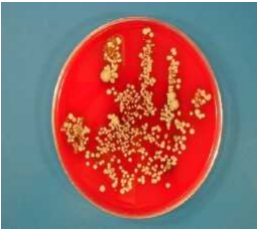
Hand Hygiene
SINGLE MOST EFFECTIVE way to prevent the spread of infection
• Pathogens can be transmitted patient to
patient by poorly sanitized hands of
healthcare professionals
• Gloves are NOT a substitute!!!
• Keeps your patients, your coworkers,
and you safe.

Slide 5
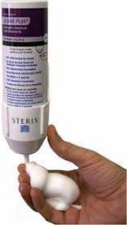
Hand Hygiene Alcohol-Based Hand Rub
          Preferred method of hand hygiene
• Quick
• Mobile
• Disinfects
https://www.cdc.gov/handhygiene/providers/index.html

Slide 6

Hand Hygiene – Soap & Water
Should be used instead of alcohol foam at certain times:
      When hands are visibly soiled
      Before eating
      After using the restroom
      Good choice after coming into contact with a patient with diarrheal illness such as Clostridium difficile
Requires 15 seconds of friction to mechanically remove microbes
https://www.cdc.gov/handhygiene/providers/index.html

Slide 7
Hand Hygiene
Corewell Health’s Hand Hygiene Quality Standard:
ALWAYS foam in, and foam
Out, if ANYTHING was touched.

Slide 8


Hand Hygiene – Artificial Fingernails
Significantly higher concentration of microorganisms than natural nails.
https://www.cdc.gov/handhygiene/providers/index.html

Slide 9
Hand Hygiene – Not just for HCP
Encourage patient hand hygiene
  After Toileting
  When leaving and returning to room
  Before eating, drinking, taking medicine
  After coughing, sneezing
  Before invasive procedures

Slide 10
Standard Precautions
Foundation for preventing transmission of
infectious agents during patient care.
Used in the care of ALL patients.
The amount/type of personal protective
equipment (PPE) worn, depends on the
task being performed.

Slide 11




Standard Precautions
Before interactions, assess how/if you may come
into contact with blood/bodily fluids:
                Wear gloves for potential exposure to hands
                Wear a gown for potential exposure to clothing
                Wear a mask for potential exposure to nose or mouth
                Wear eye protection for potential exposure to eyes

Slide 12
Transmission-Based Precautions
Used in addition to standard precautions.
When known or suspect multi-drug resistant
organism (MDRO) or something that can be
transmitted from patient to patient or between
patients and staff.
Based on HOW the virus or bacteria is transmitted.

Slide 13


How are diseases transmitted?
Contact
Droplet
Airborne

Slide 14
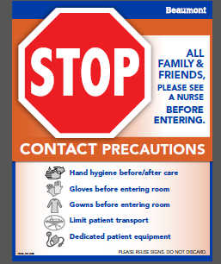
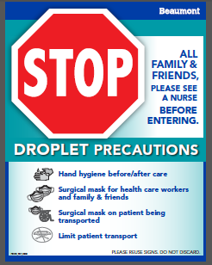
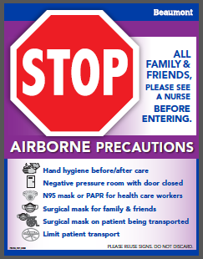
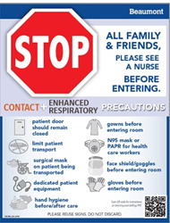
Precautions

Slide 15
Cleaning/Disinfection
Who?
Everyone
What?
Patient Care Equipment
When?
Between Every Patient

Slide 16
Cleaning/Disinfection – Low Level Disinfection
For “non-critical items” that come into contact with intact skin
Includes IV pumps, bedside tables, computers, keyboards,
WOWs, bedside commodes, etc.
Kills most bacteria, some fungi and viruses
Refer to label for wet contact time
https://www.cdc.gov/infectioncontrol/guidelines/environmental/background/services.html

Slide 17


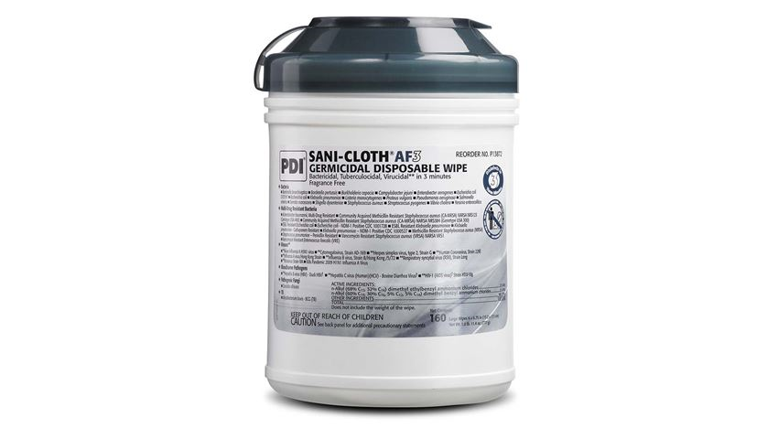
Cleaning/Disinfection – Low Level Disinfection
Purple Top
Orange Top
Grey Top
SUPER SANI-CLOTH wipes:
2 minutes
To be fully effective on bacteria including Mycobacterium tuberculosis (TB). Does not kill C. diff spores
SANI-CLOTH BLEACH wipes:
4 minutes
To be fully effective on bacteria including C. diff spores
SANI-CLOTH AF3 wipes:
3 minutes
To be fully effective on bacteria. Does not kill C. diff spores. Used for specialty equipment only.

Slide 18


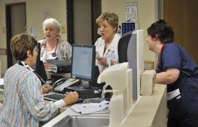


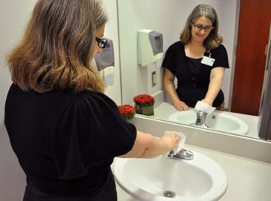

Whatever our job, we all play
a role in safety.

Slide 19
You Can Make a Difference!
Work Practice Controls:
  Hand washing saves lives; Wash in, Wash out
  Follow Standard and Transmission Based Precautions.
  Keep food & drink in break rooms
Reducing the transmission of disease:
  Adhere to cleaning schedules
  Proper disinfection of equipment
Engineering Controls:
  Safe handling of needles & contaminated objects
  Negative pressure rooms
Follow policies & procedures; Set a good example for coworkers, patients, visitors, and families.

Slide 20
Contact Us:
Infection Prevention Department
Roxanne Newsom, RN
Infection Preventionist
947-521-8124
  Lynn Sackett-Hodge, BSN, RN
  Infection Preventionist
  947-521-8740

Slide 21
Infection Prevention is Everyone’s Responsibility!

