Slide 1



What Should You Learn From A Breast Surgeon?
Zakiya Shakir, MD
Breast Surgical Oncology
October 3, 2024

Slide 2
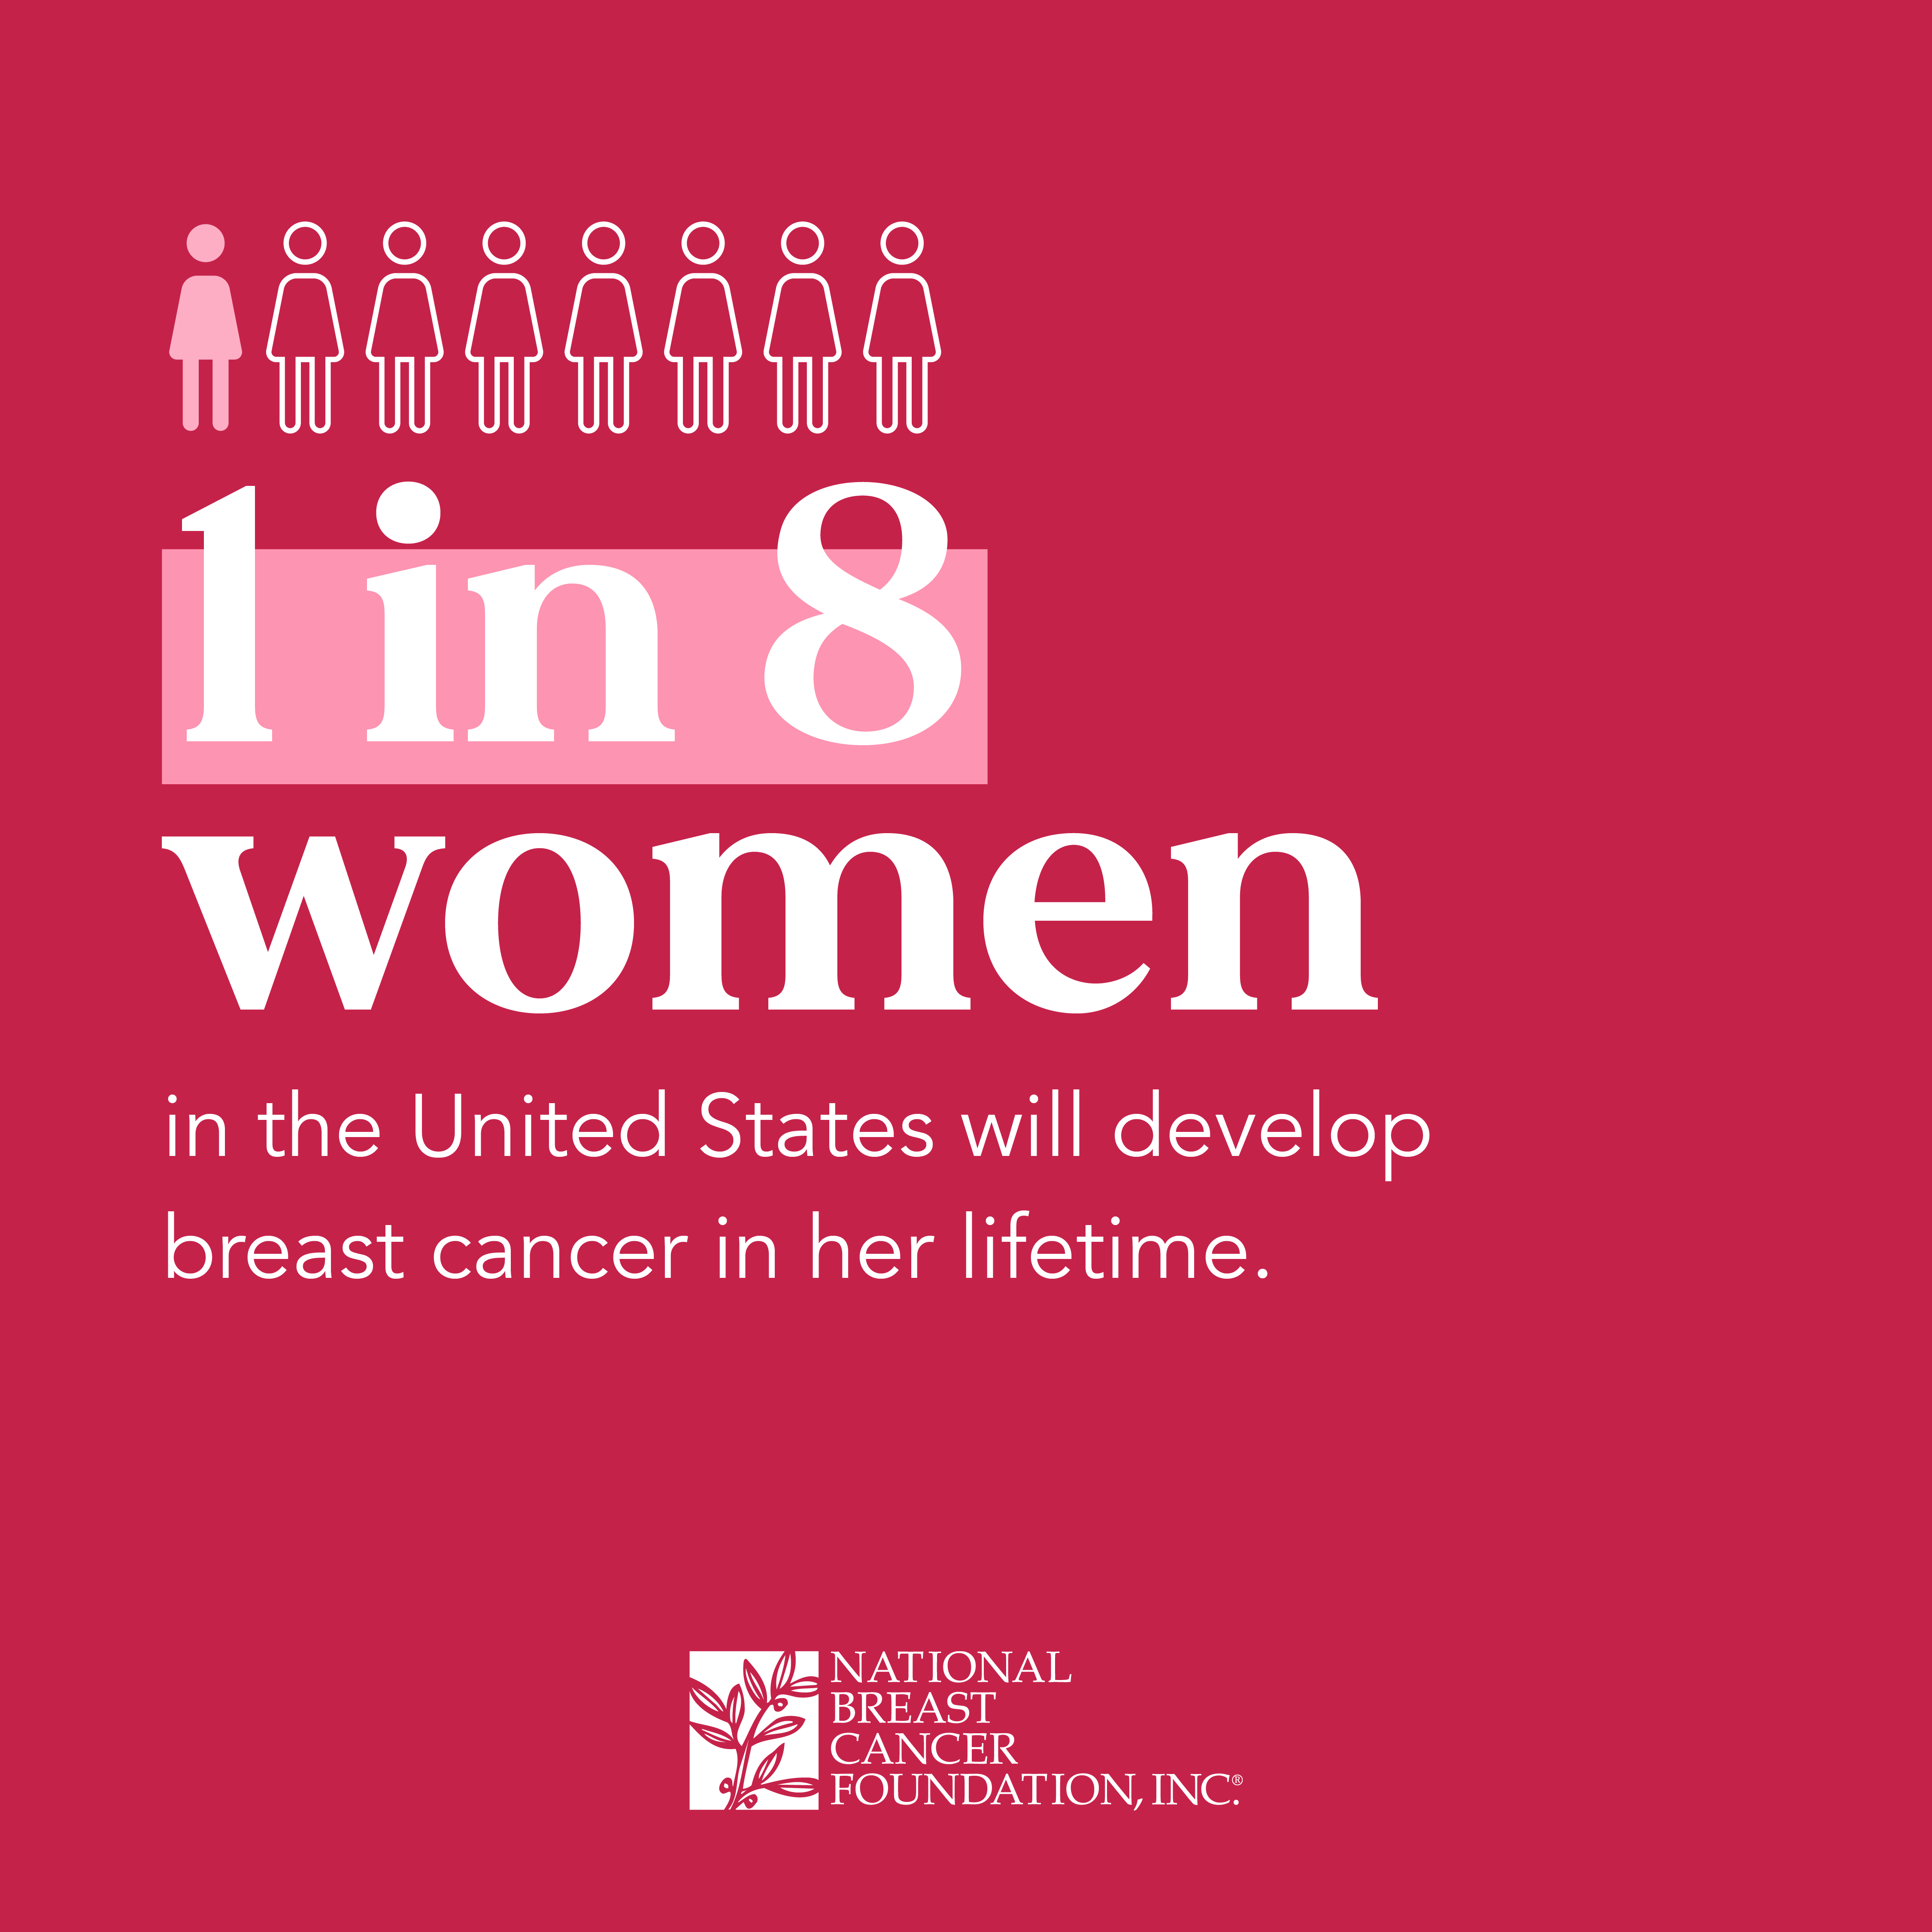
Objectives
1. To understand the role of a breast surgeon in treating breast cancer.
2. To review normal breast anatomy and be able to perform a self-breast exam.
3. To understand the factors that can lead to an increased risk of breast cancer.
4. To review of various types of breast cancer and their general treatment algorithms.

Slide 3



Introduction
Background
  Oklahoma —> Tennessee —> Michigan
Training
  College —> Medical school —> Surgical residency —> Fellowship
Things I love about my job
  Taking care of women
  Collaborating with other specialties
  Strongly evidence-based field
  Rapid advancements = improvement

Slide 4
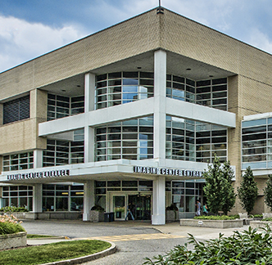
Comprehensive Breast Care Center
NSABP accreditation
High volume center
High risk breast clinic
Multidisciplinary setting under one roof
LOTS of resources

Slide 5
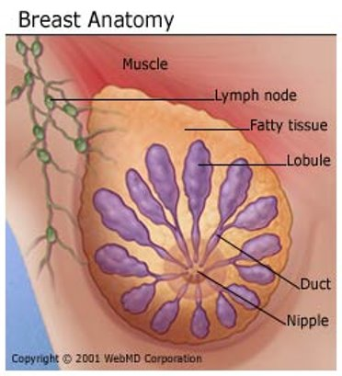
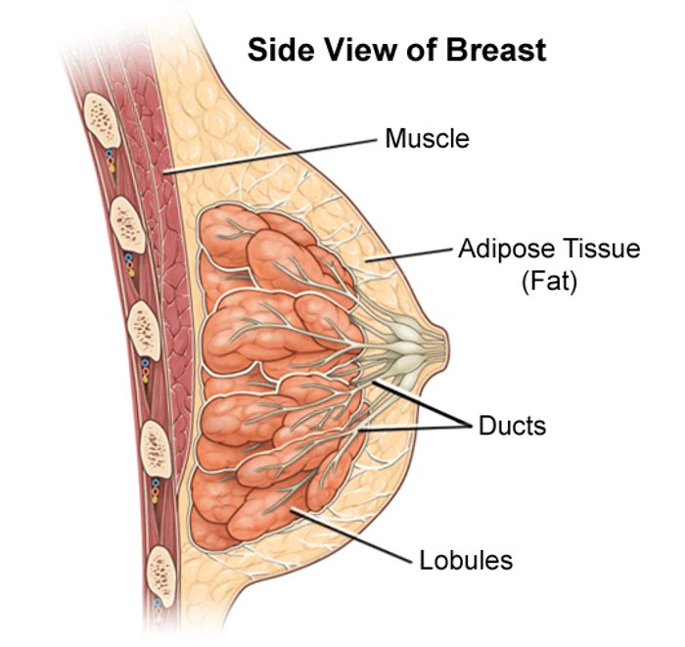
Breast Anatomy
Glands (lobules)
Milk ducts
Connective tissue
Breast tissue naturally extends from collarbone to fold under the breast, and from the breastbone to the armpit

Slide 6
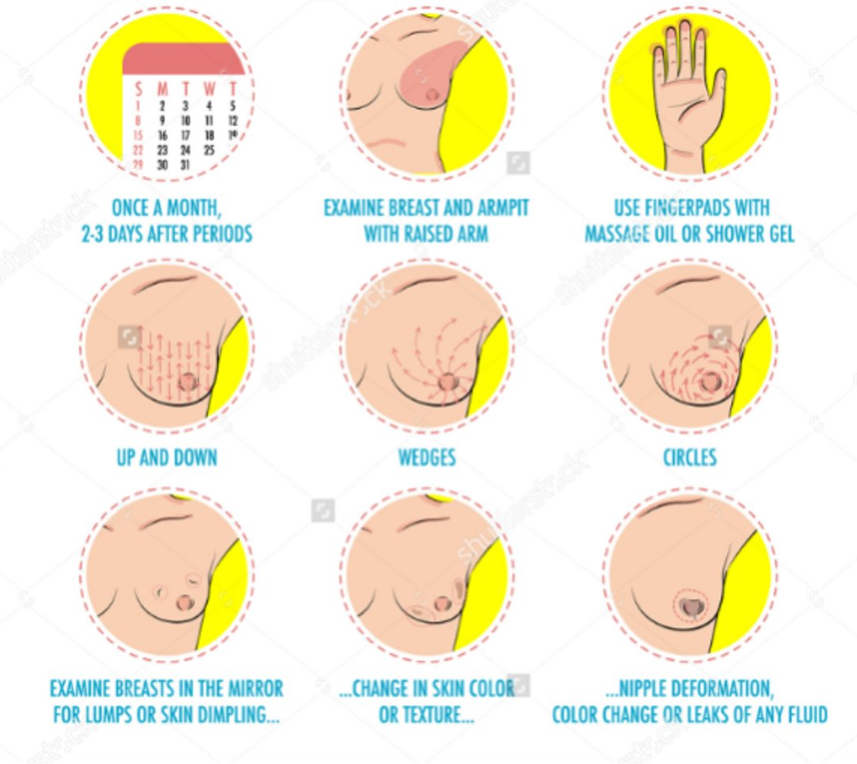
We are all different!
Breasts are sisters, not twins
Different sizes, shapes, textures
Breasts can change over time - this is normal
KNOW YOUR NORMAL!

Slide 7
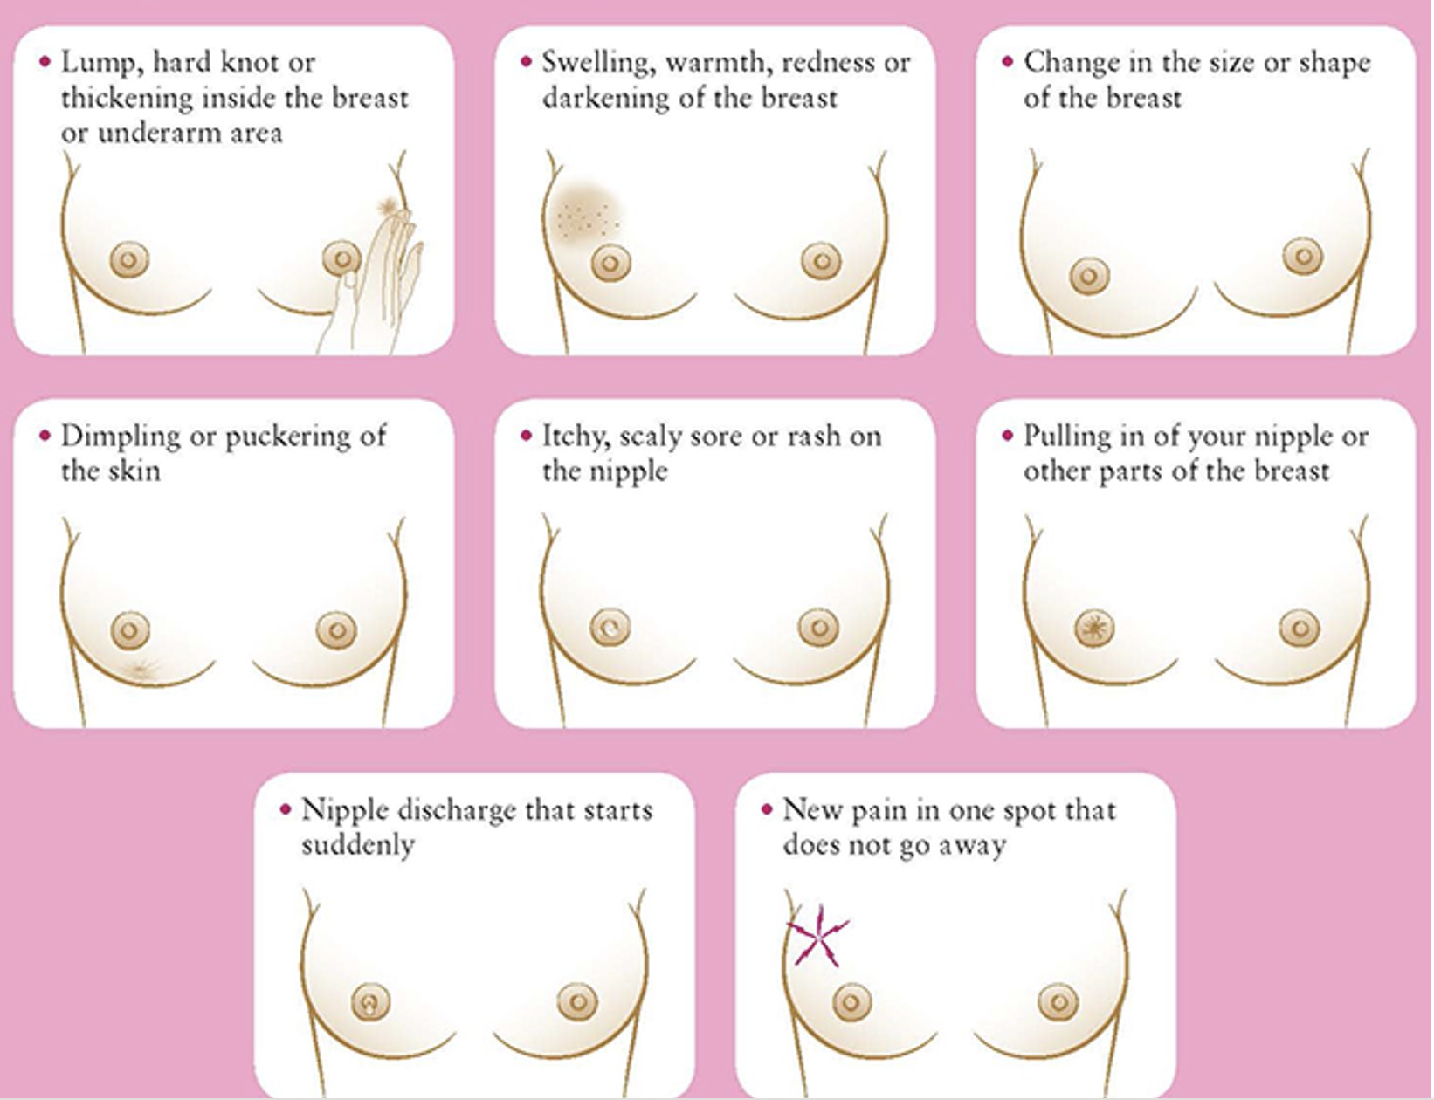
Abnormal Signs/Symptoms
New lump in breast or armpit
Spontaneous nipple discharge
New nipple inversion
Skin changes
  Rash that does not go away
  “Orange peel” appearance
Pain without other symptoms is rarely a sign of cancer
YOU SHOULD DISCUSS THESE CONCERNS WITH YOUR PCP!

Slide 8
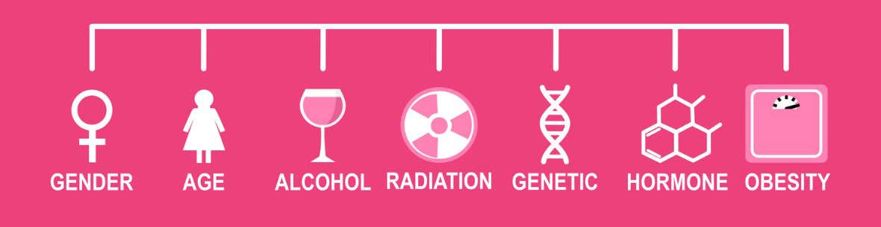
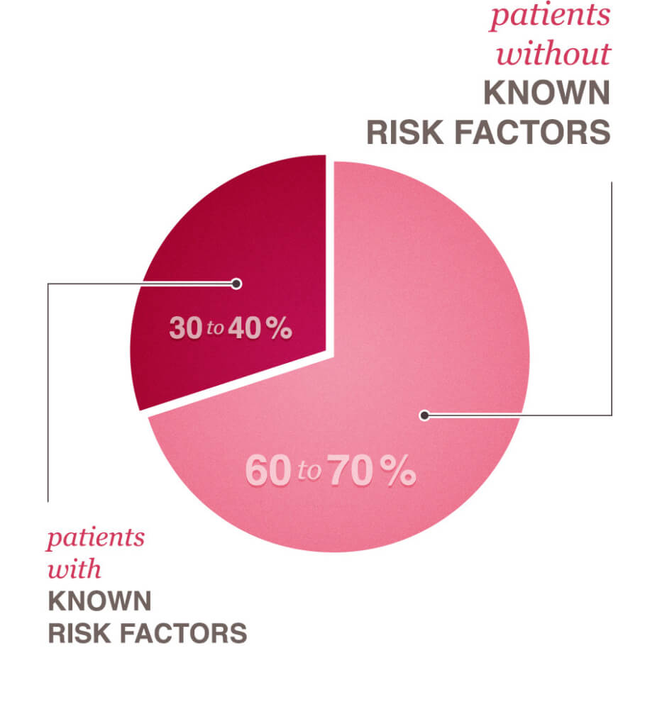
Risk Factors
Hormone-related
Family history
  Genetic mutations
Breast density
Previous biopsies with high-risk pathology
Chest radiation for lymphoma
Two biggest risk factors:
Being female and getting older!

Slide 9
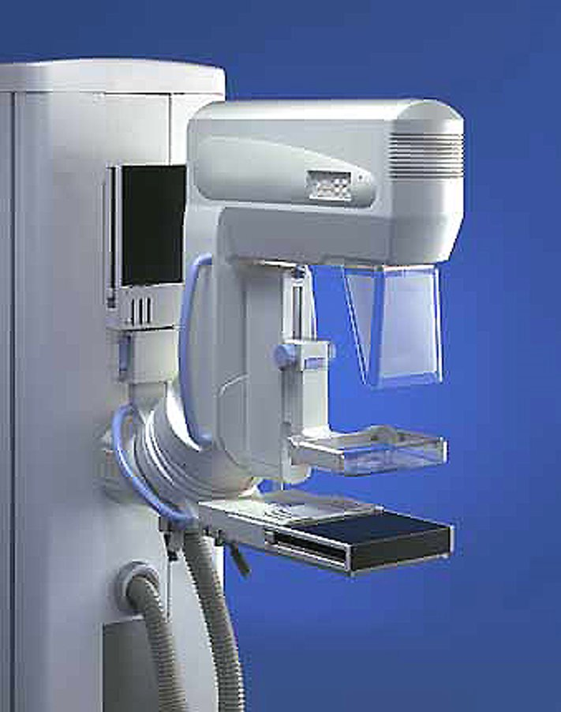
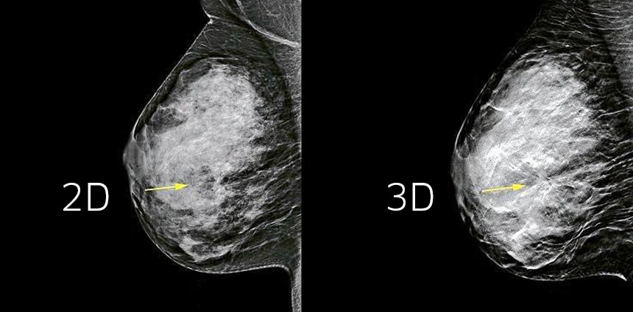
Screening for Breast Cancer
Risk assessment starting at age 25 by PCP
  Breast awareness (self breast exams)
  Clinical breast exam (by provider)
  Any risk factors?

Slide 10
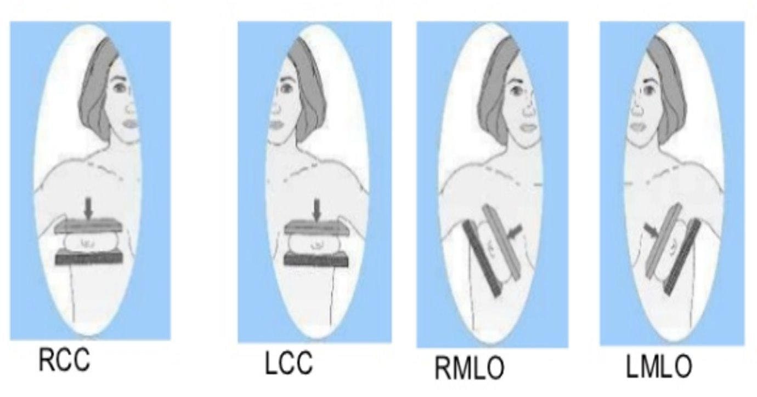
Screening Tests
Average risk:
  Annual screening mammogram starting at age 40
  3D mammogram = tomography
  Can consider ultrasound or MRI for high breast density (pros and cons to both)
High risk:
  Add ultrasound or MRI in addition to mammogram
  Add clinical breast exam every 6-12 months

Slide 11
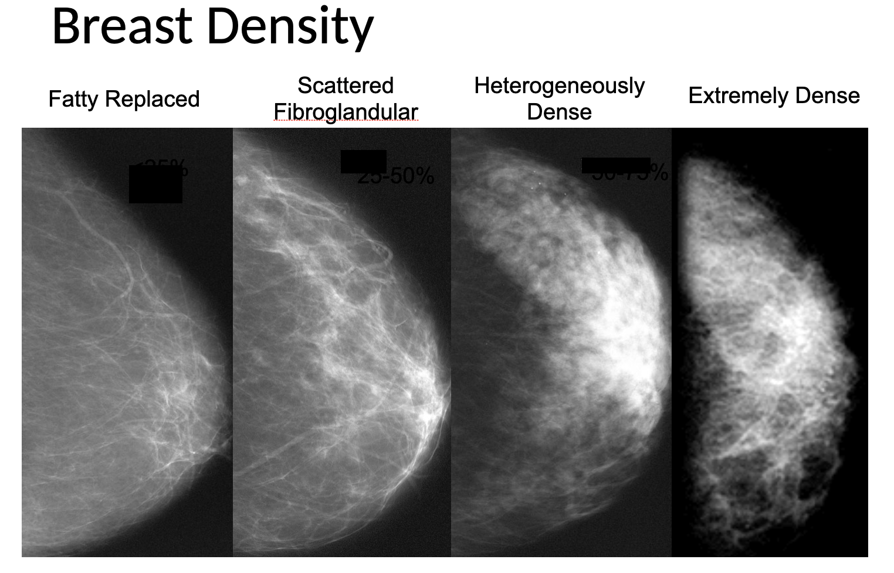

Slide 12
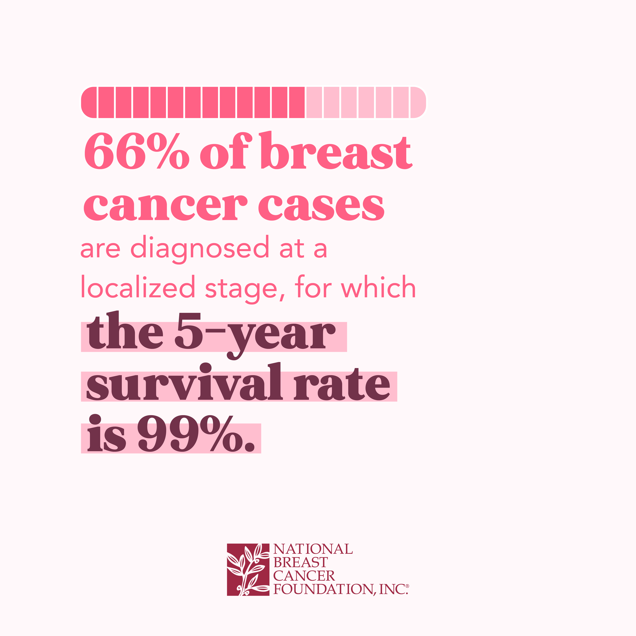
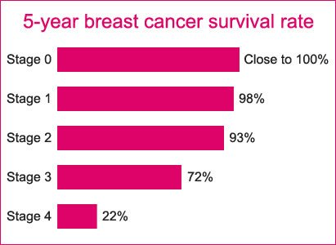
Early detection saves lives!

Slide 13
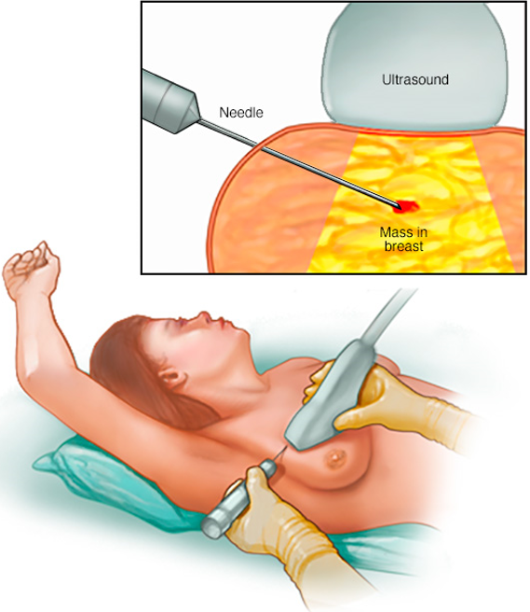
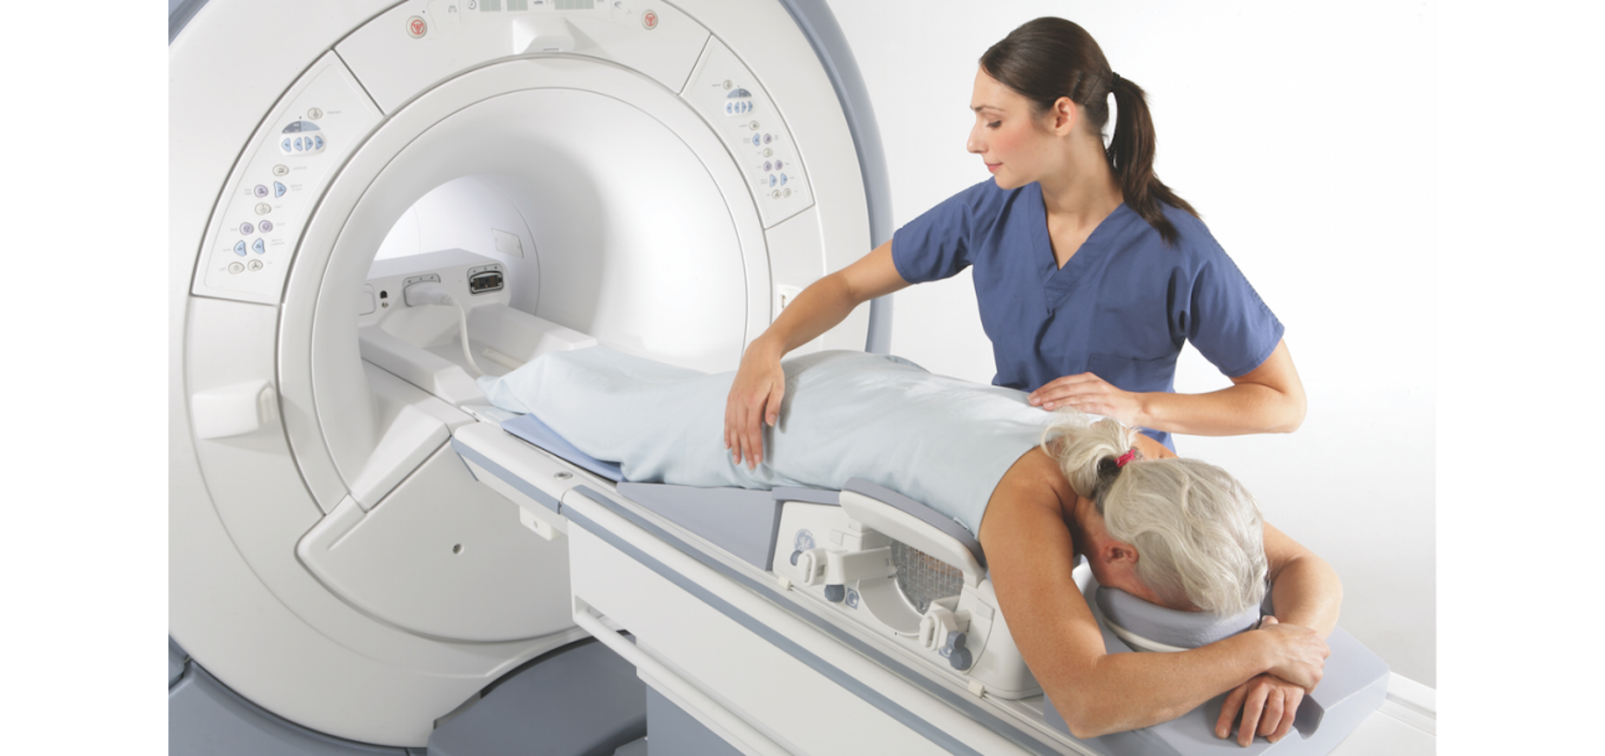
Methods of Diagnosis
Imaging
  Screening imaging
  Diagnostic imaging
Biopsy
  Can be done using ultrasound, mammogram, or MRI
Pathology
  Radiology-pathology concordance
Evaluation by treatment team
  Clinical exam

Slide 14
Types of Breast Cancer - Most Common
DCIS (Non-invasive breast cancer)
  25% of all breast cancer diagnoses
  “Stage zero”
Invasive ductal cancer
  85% of invasive cancers
Invasive lobular cancer
  15% of invasive cancers

Slide 15
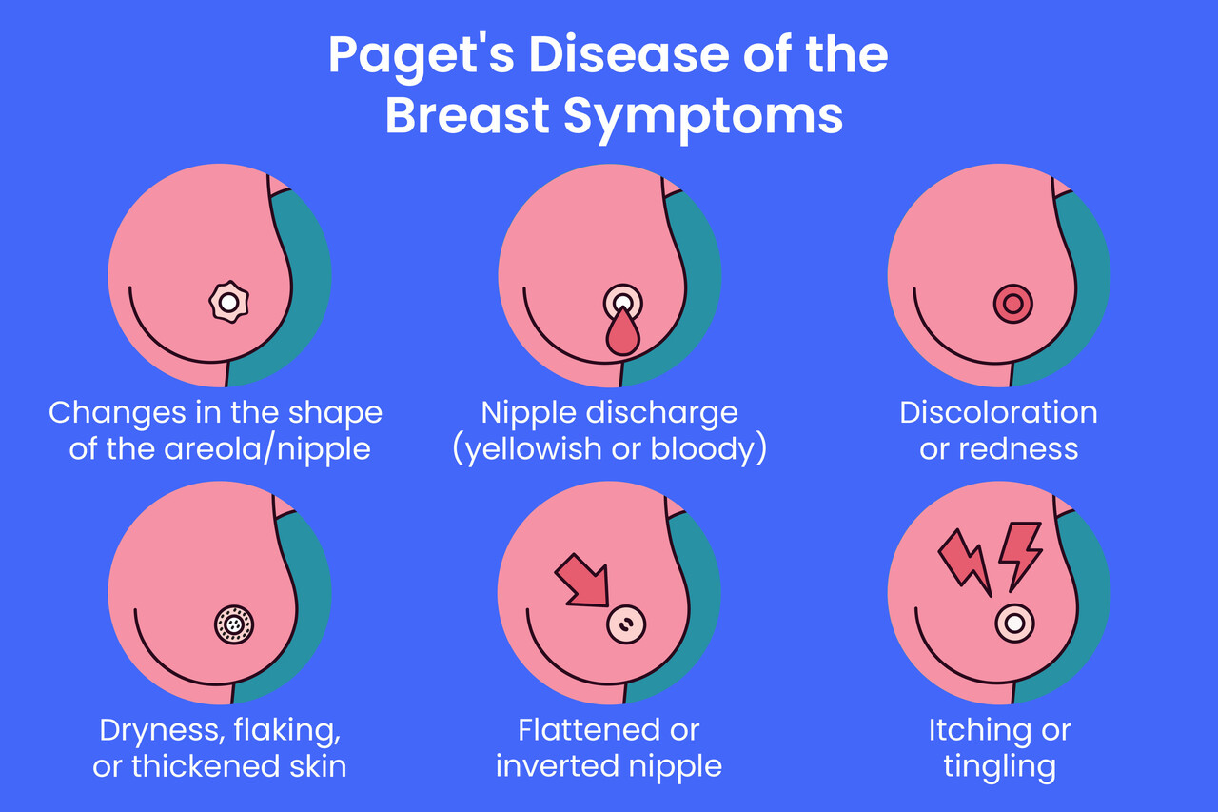
Types of Breast Cancer - Less Common
Inflammatory breast cancer
  Tends to be more aggressive with a higher risk of recurrence
Paget’s disease
  Nipple changes are the most common symptom

Slide 16
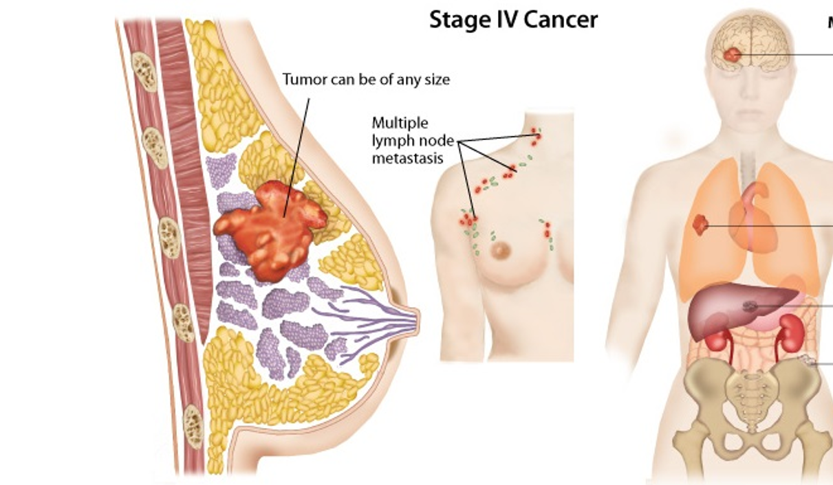
Staging
Two ways to determine stage:
Anatomy/pathology stage
  Based on three factors
    Size of tumor in breast
    Lymph node involvement (number and location)
    Presence of any metastatic deposits
Prognostic stage
  Also includes grade and tumor receptors (hormone and HER2 status)

Slide 17
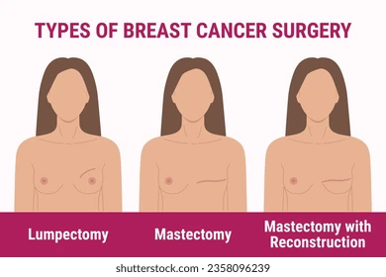
Treatment Options
Receptors = how we describe cancer cell behavior
  Hormones (Estrogen and Progesterone)
  HER2
  Treatments vary based on receptor type
Two goals
  Removal of tumor
  Prevention of recurrence

Slide 18
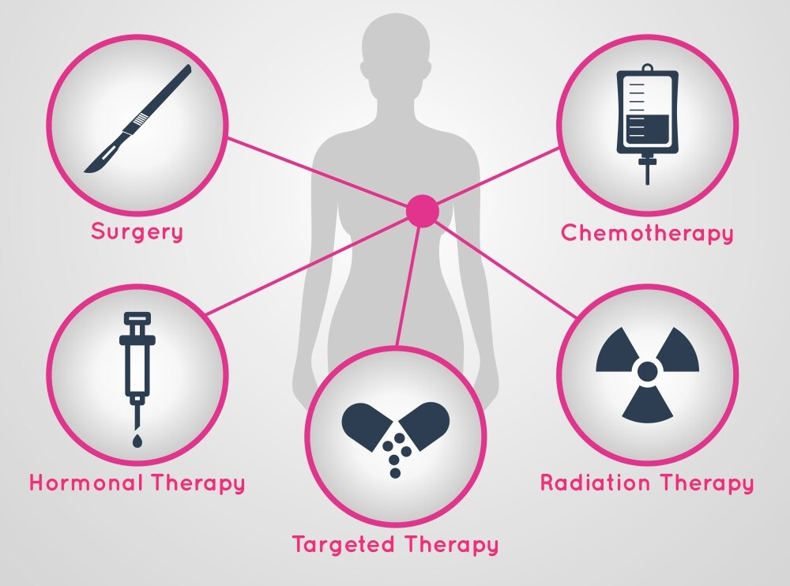
Treatments
Based on stage and tumor behavior
  Chemotherapy
  Surgery
  Radiation
  Immunotherapy
  Personalized treatment!

Slide 19
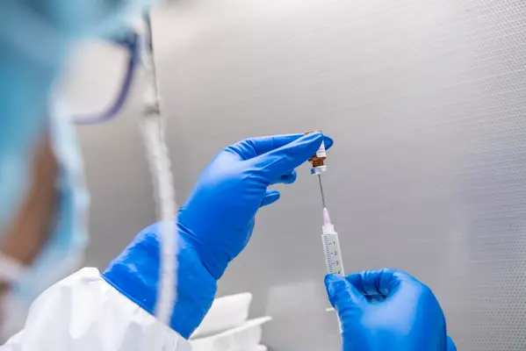
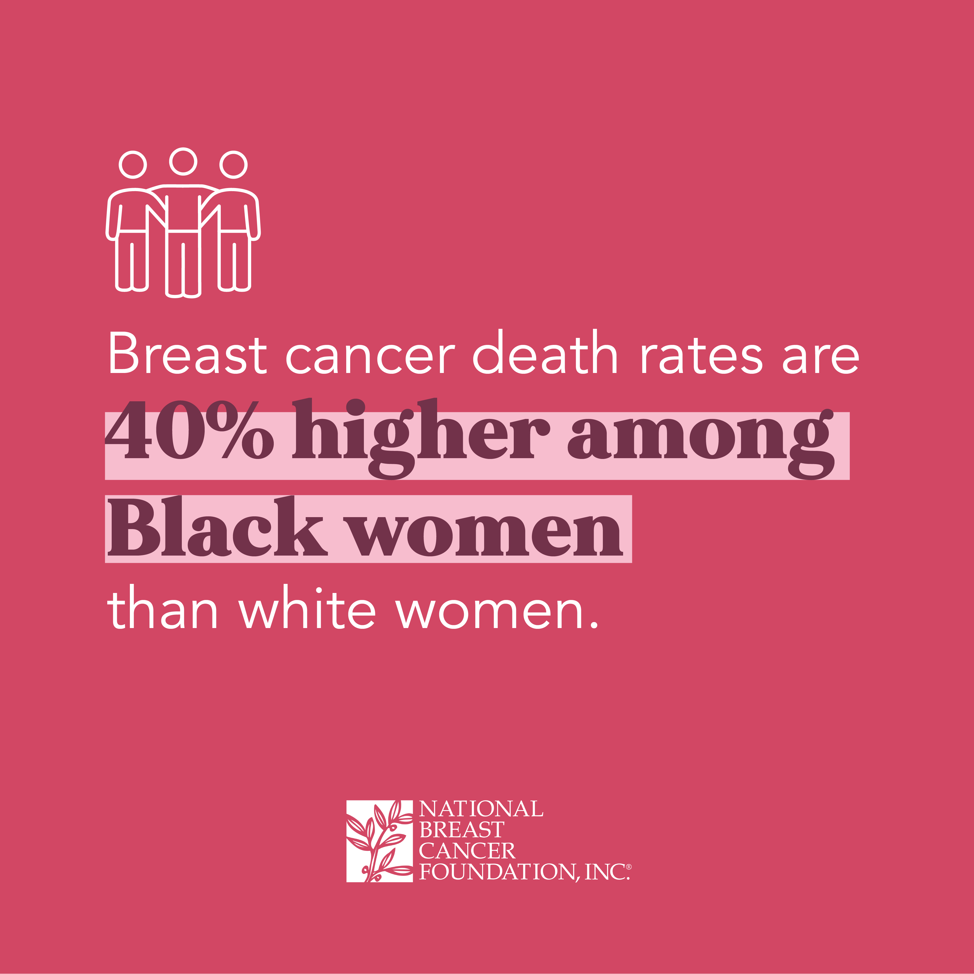
Areas of Ongoing Research
Reducing certain treatments
  Radiation
  Anti-estrogen medication
  Lymph node sampling
TNBC vaccine
Newer targeted treatments
Disparities in breast cancer diagnosis and care
We keep learning!

Slide 20
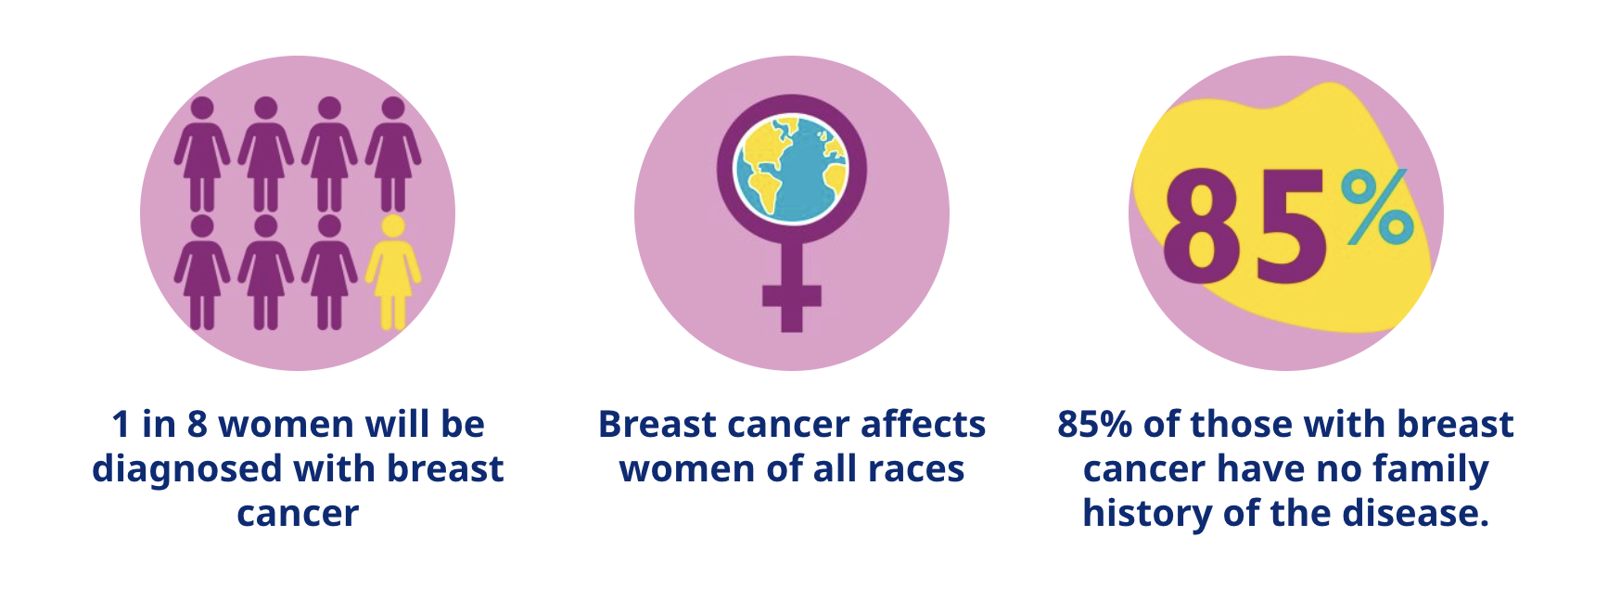
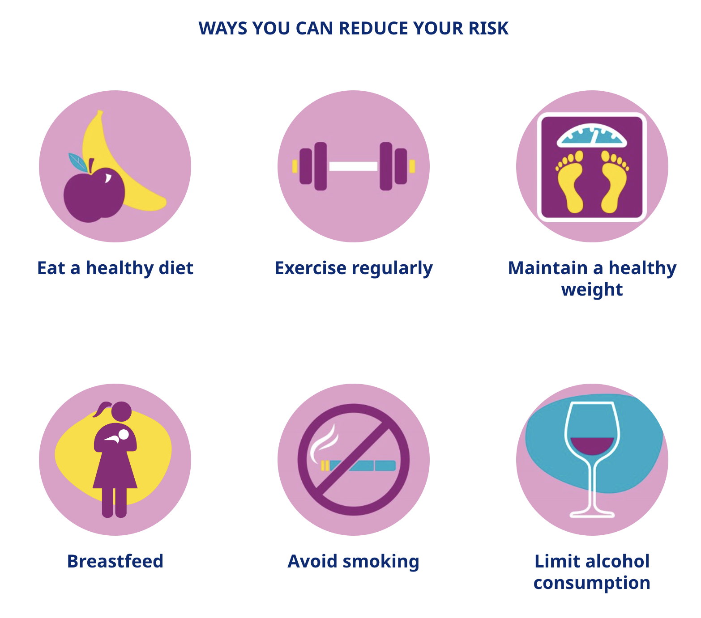
Prevention and Screening

Slide 21

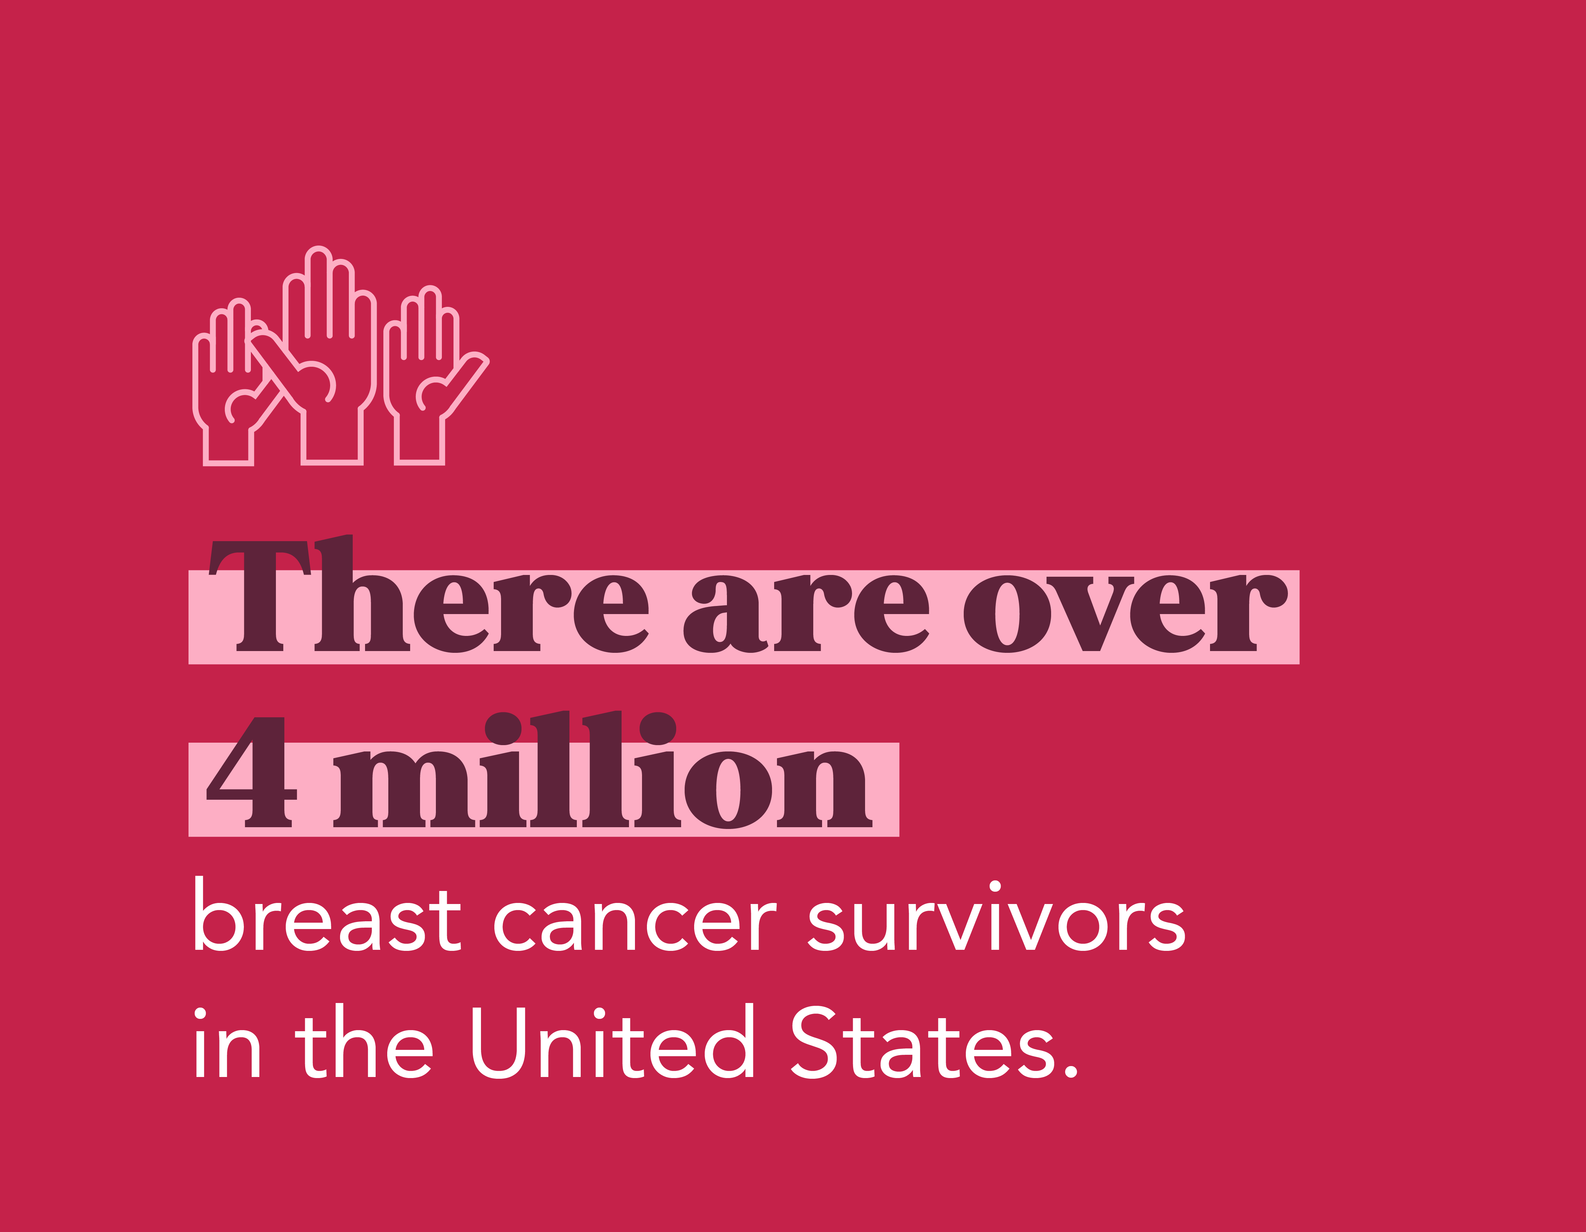
Survivorship
Continue breast awareness, self-breast exams
Continue breast imaging if you still have breast tissue
Anti-estrogen pill if applicable
Monitor for lymphedema
Diet, exercise, weight control
Minimize alcohol intake
Mindfulness based practices

Slide 22

Questions?
Zakiya Shakir, MD
Breast Surgical Oncology
248-551-3300

