Slide 1
Breast Cancer and
Skin Cancer
Presentation by Lori Haddad, DO, Dermatology

Slide 2
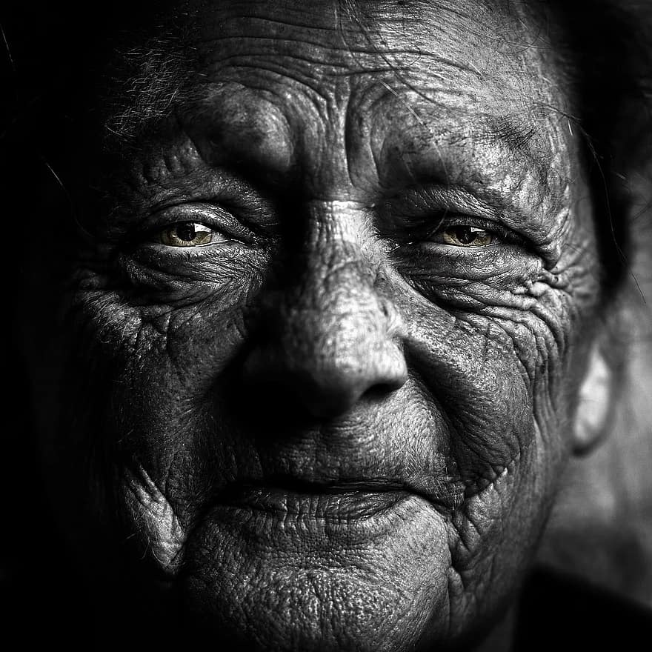

Slide 3
Epidemiologic studies have provided suggestive evidence of a link between cutaneous melanoma (CM) and breast cancer (BC).
Carriers of mutations in the breast cancer predisposition gene, BRCA2, have an increased risk of melanoma.
Carriers of mutations in the melanoma susceptibility gene, CDKN2A, exhibit a higher than expected risk of breast cancer.
These findings raise the possibility that pathways involved in the development of CM and BC overlap and that survivors of one cancer may be prone to develop the other.
To this end, we set out to determine if survivors of female BC in the Surveillance, Epidemiology and End Result (SEER) database are at increased risk for CM and vice versa.
We followed female BC patients registered in the 1973-1999 SEER database for development of a second CM and female CM patients for the development of a second BC.
The expected number of cases was then compared to the observed number of cases using standardized incidence ratios.
Overall, we found a modest but statistically significant increased risk of CM among female BC survivors and vice versa.
Among young BC patients, we observed a 46% elevated risk of a second CM.
Women who underwent radiation therapy exhibited a 42% increased risk for CM.
The risks of BC among female CM survivors and CM among BC survivors were also elevated, albeit to a much lesser degree (overall, 11% and 16%, respectively).
We found a mutual association between female BC and CM. The elevated risk for CM, especially among younger BC patients, suggests that the genetic observations from high-risk groups may also be operative at a much lower level in the general BC population.
Goggins W, Gao W, Tsao H. Association between female breast cancer and cutaneous melanoma. Int J Cancer. 2004 Sep 20;111(5):792-4. doi: 10.1002/ijc.20322. PMID: 15252852.

Slide 4
Key Points
Question Are patients with breast cancer who receive radiation therapy at a higher risk of developing subsequent nonkeratinocyte (ie, not squamous and basal cell) skin cancers?
Findings This cohort study of 875 880 patients with newly diagnosed breast cancer found a significantly increased risk of development of posttreatment nonkeratinocyte skin cancers, particularly melanoma and hemangiosarcoma.
Meaning These results suggest that although nonkeratinocyte skin cancer is a rare occurrence, physicians caring for patients with breast cancer should be aware of this elevated risk to help inform follow-up care for survivors.
99.3% were women, 51.6% were aged older than 60 years, and 50.3% received radiation therapy.
A total of 11.2% patients identified as Hispanic, 10.1% identified as non-Hispanic Black, and 69.5% identified as non-Hispanic White. From 2000 to 2019, there were 3839 patients with nonkeratinocyte skin cancer, including melanoma (3419 [89.1%]), Merkel cell carcinoma (121 [3.2%]), hemangiosarcoma (104 [2.7%]), and 32 other nonkeratinocyte skin cancers (195 [5.1%]), documented to occur after breast cancer treatment.
The risk of nonkeratinocyte skin cancer diagnosis after breast cancer treatment with radiation was 57% higher (SIR, 1.57 [95% CI, 1.45-1.7]) than that of the general population when considering the most relevant site: the skin of the breast or trunk. When risk at this site was stratified by skin cancer subtype, the SIRs for melanoma and hemangiosarcoma were both statistically significant at 1.37 (95% CI, 1.25-1.49) and 27.11 (95% CI, 21.6-33.61), respectively.
Receipt of radiation therapy was associated with a greater risk of nonkeratinocyte skin cancer compared with chemotherapy and surgical interventions.
Rezaei SJ, Eid E, Tang JY, Kurian AW, Kwong BY, Linos E. Incidence of Nonkeratinocyte Skin Cancer After Breast Cancer Radiation Therapy. JAMA Netw Open. 2024;7(3):e241632. doi:10.1001/jamanetworkopen.2024.1632

Slide 5
Highlights:
There is a significant risk association between breast cancers and melanomas.
• Younger age and use of radiation are potential risk factors for second primary cancers.
• The positive breast cancer-melanoma association can be genetically dependent.
• Socio-cultural factors and surveillance bias may be attributed to previous findings.
Arunan Jeyakumar, Terence C. Chua, Alfred King-Yin Lam, Vinod Gopalan,
The Melanoma and Breast Cancer Association: An Overview of their ‘Second Primary Cancers’ and the Epidemiological, Genetic and Biological correlations,
Critical Reviews in Oncology/Hematology,
Volume 152,
2020,
102989,
ISSN 1040-8428,
https://doi.org/10.1016/j.critrevonc.2020.102989.
(https://www.sciencedirect.com/science/article/pii/S104084282030127X)

Slide 6
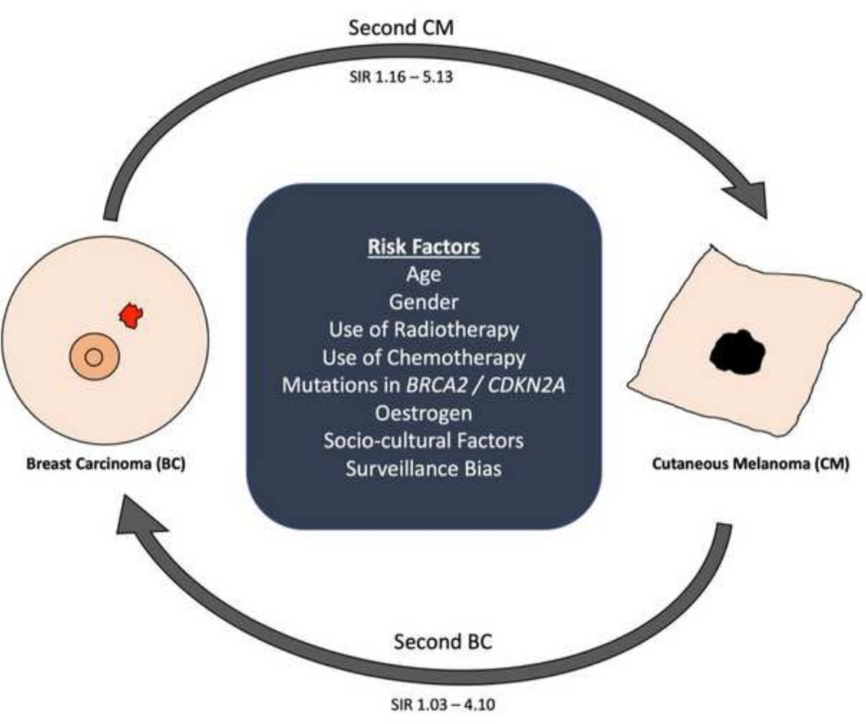
Connection & Risk Factors

Slide 7
MTHFR MUTATION AND BREAST, CERVICAL, OVARIAN, AND ENDOMETRIAL CANCER
de Cássia Carvalho Barbosa R, da Costa DM, Cordeiro DE, Vieira AP, Rabenhorst SH. Interaction of MTHFR C677T and A1298C, and MTR A2756G gene polymorphisms in breast cancer risk in a population in Northeast Brazil. Anticancer Res. 2012 Nov;32(11):4805-11. PMID: 23155246. CASE CONTROL STUDY
He JM, Pu YD, Wu YJ, Qin R, Zhang QJ, Sun YS, Zheng WW, Chen LP. Association between dietary intake of folate and MTHFR and MTR genotype with risk of breast cancer. Genet Mol Res. 2014 Oct 31;13(4):8925-31. doi: 10.4238/2014.October.31.7. PMID: 25366783. CASE CONTROL STUDY
Qi X, Ma X, Yang X, Fan L, Zhang Y, Zhang F, Chen L, Zhou Y, Jiang J. Methylenetetrahydrofolate reductase polymorphisms and breast cancer risk: a meta-analysis from 41 studies with 16,480 cases and 22,388 controls. Breast Cancer Res Treat. 2010 Sep;123(2):499-506. doi: 10.1007/s10549-010-0773-7. Epub 2010 Feb 5. PMID: 20135343. META-ANALYSIS
Liu W, Li Y, Li R, Han X, Ma Y, Liu B, Kong X. ASSOCIATION OF MTHFR A1298C POLYMORPHISM WITH BREAST CANCER AND/OR OVARIAN CANCER RISK: AN UPDATED META-ANALYSIS. Afr J Tradit Complement Altern Med. 2016 Aug 12;13(5):72-86. doi: 10.21010/ajtcam.v13i5.11. PMID: 28487897; PMCID: PMC5416649. META-ANALYSIS
Shi XY, Shen Q. MTHFR A1298C polymorphism and ovarian cancer risk: a meta-analysis. Genet Mol Res. 2015 Jul 27;14(3):8211-8. doi: 10.4238/2015.July.27.8. PMID: 26345746. META-ANALYSIS
Yi K, Yang L, Lan Z, Xi M. The association between MTHFR polymorphisms and cervical cancer risk: a system review and meta analysis. Arch Gynecol Obstet. 2016 Sep;294(3):579-88. doi: 10.1007/s00404-016-4037-6. Epub 2016 Feb 15. PMID: 26879954. META-ANALYSIS
Wang Z, Li K, Ouyang L, Iko H, Safi AJ, Gao S. Effects of methylenetetrahydrofolate reductase single-nucleotide polymorphisms on breast, cervical, ovarian, and endometrial cancer susceptibilities. Chronic Dis Transl Med. 2021 Aug 12;7(3):169-181. doi: 10.1016/j.cdtm.2021.06.003. PMID: 34505017; PMCID: PMC8413124. REVIEW

Slide 8
MTHFR MUTATION AND BREAST, CERVICAL, OVARIAN, AND ENDOMETRIAL CANCER Continued:
Liu W, Li Y, Li R, Han X, Ma Y, Liu B, Kong X. ASSOCIATION OF MTHFR A1298C POLYMORPHISM WITH BREAST CANCER AND/OR OVARIAN CANCER RISK: AN UPDATED META-ANALYSIS. Afr J Tradit Complement Altern Med. 2016 Aug 12;13(5):72-86. doi: 10.21010/ajtcam.v13i5.11. PMID: 28487897; PMCID: PMC5416649. META-ANALYSIS
Shi XY, Shen Q. MTHFR A1298C polymorphism and ovarian cancer risk: a meta-analysis. Genet Mol Res. 2015 Jul 27;14(3):8211-8. doi: 10.4238/2015.July.27.8. PMID: 26345746. META-ANALYSIS
Yi K, Yang L, Lan Z, Xi M. The association between MTHFR polymorphisms and cervical cancer risk: a system review and meta analysis. Arch Gynecol Obstet. 2016 Sep;294(3):579-88. doi: 10.1007/s00404-016-4037-6. Epub 2016 Feb 15. PMID: 26879954. META-ANALYSIS
Wang Z, Li K, Ouyang L, Iko H, Safi AJ, Gao S. Effects of methylenetetrahydrofolate reductase single-nucleotide polymorphisms on breast, cervical, ovarian, and endometrial cancer susceptibilities. Chronic Dis Transl Med. 2021 Aug 12;7(3):169-181. doi: 10.1016/j.cdtm.2021.06.003. PMID: 34505017; PMCID: PMC8413124. REVIEW
Petrone I, Bernardo PS, Dos Santos EC, Abdelhay E. MTHFR C677T and A1298C Polymorphisms in Breast Cancer, Gliomas and Gastric Cancer: A Review. Genes (Basel). 2021 Apr 17;12(4):587. doi: 10.3390/genes12040587. PMID: 33920562; PMCID: PMC8073588. REVIEW
Omran MH, Fotouh BE, Shousha WG, Ismail A, Ibrahim NE, Ramadan SS. Strong Correlation of MTHFR Gene Polymorphisms with Breast Cancer and its Prognostic Clinical Factors among Egyptian Females. Asian Pac J Cancer Prev. 2021 Feb 1;22(2):617-626. doi: 10.31557/APJCP.2021.22.2.617. PMID: 33639682; PMCID: PMC8190368. REVIEW
Ergul E, Sazci A, Utkan Z, Canturk NZ. Polymorphisms in the MTHFR gene are associated with breast cancer. Tumour Biol. 2003 Nov-Dec;24(6):286-90. doi: 10.1159/000076460. PMID: 15004488. CASE-CONTROL STUDY
Chen X, Ahamada H, Zhang T, Bai Z, Wang C. Association of Intake Folate and Related Gene Polymorphisms with Breast Cancer. J Nutr Sci Vitaminol (Tokyo). 2019;65(6):459-469. doi: 10.3177/jnsv.65.459. PMID: 31902858. REVIEW

Slide 9
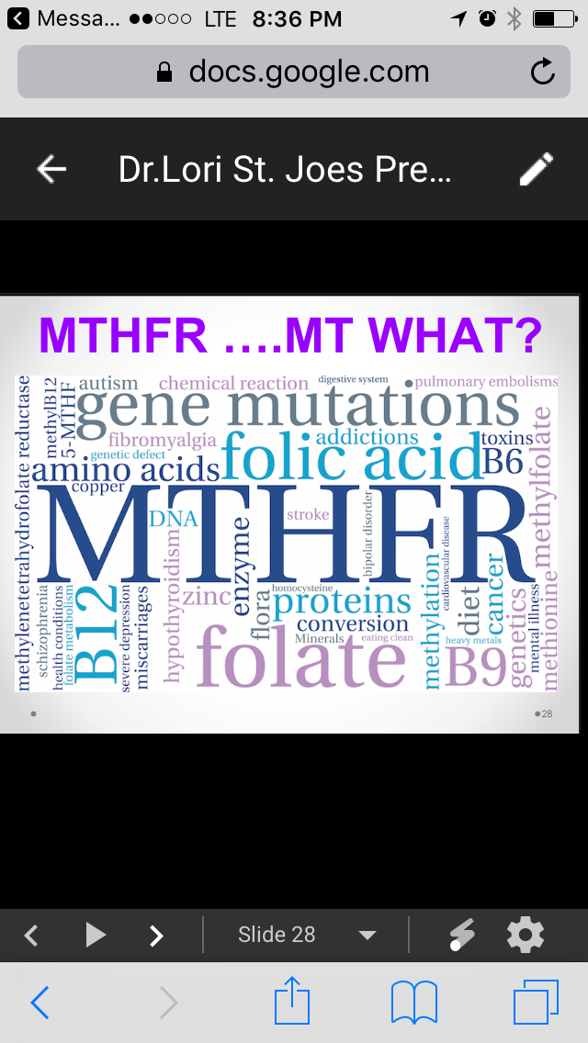

Slide 10
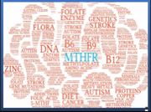

Slide 11
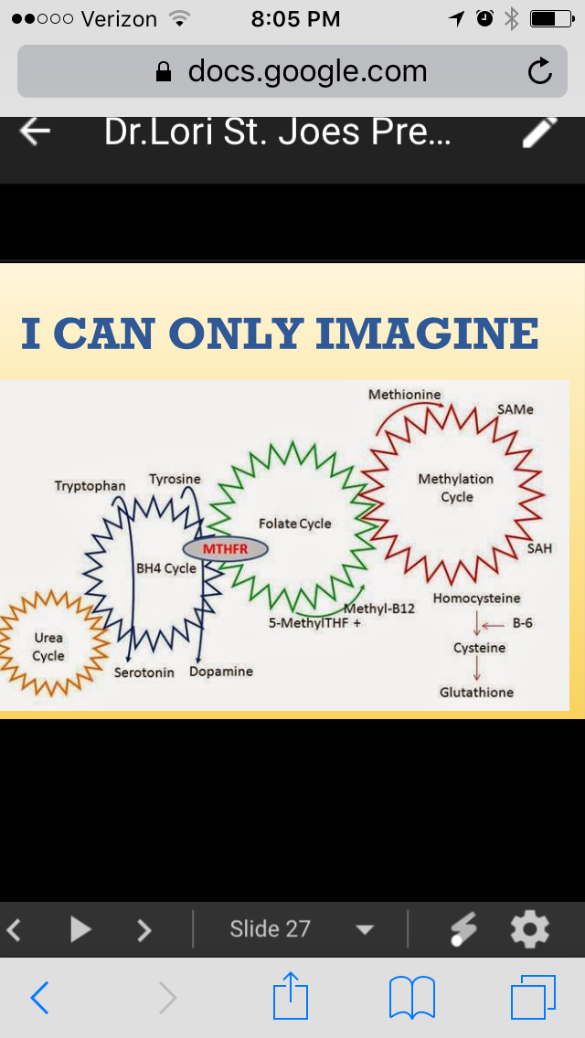

Slide 12
3 Case Presentations:
75 y/o white female presents with “rash on chest”
40 y/o black female presents with “rash on chest”
c) 39 y/0 white female presents with “rash on chest”
HPI:
+/- pruritus; duration X months; +dx’d as eczema/contact
+/- pruritus; duration X several months; +oozing; -treatment
WORK HX: Mother
TREATMENT PLAN:
SOC HX: non-smoker
WORK UP: FHX: Unknown

Slide 13
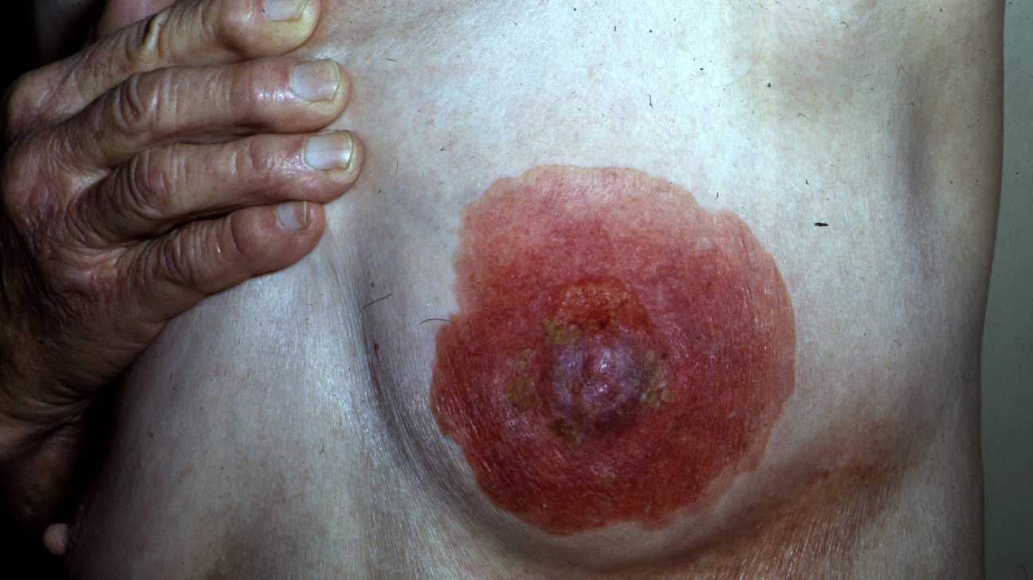
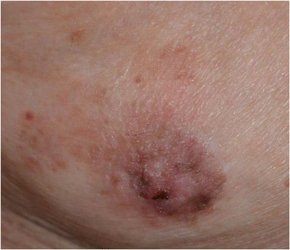
PAGETS DISEASE
EPIDEMIOLOGY-
1-3 % new cases of female breast cancer/year in the U.S.
Peak incidence: 50-60 year olds
CLINICAL PRESENTATION
  Hallmark: UNILATERAL scaly, dry patch on nipple/areola
  Late Stage: raw, vesicular, oozing, ulcerated patches or plaques
SKIN BIOPSY— GOLD STANDARD
  Diagnosis : FULL- THICKNESS WEDGE EXCISION
may contain lactiferous ducts, which may identify DCIS
  The histologic hallmark of PDB: presence of malignant, intraepithelial adenocarcinoma cells (Paget cells) singly or in small groups within the epidermis of the nipple
TREATMENT
I MASTECTOMY + whole breast radiotherapy (RT)
  No data supporting use of Tamoxifen
5
Treatment: IMMEDIATE MASTECTOMY + Whole Body Radiotherapy (RT)
No data supporting use of Tamoxifen.

Slide 14
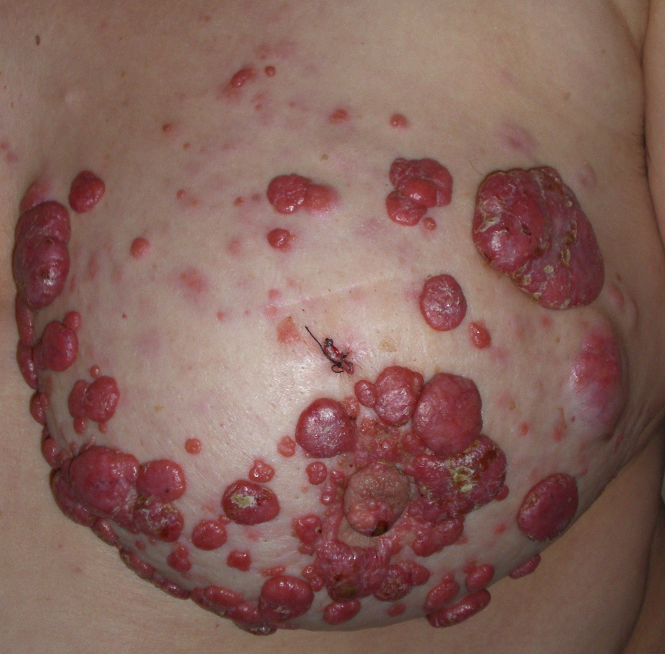
Metastatic Breast Cancer

Slide 15
Evaluate Patients total body with 3-D approach
Epidermis
Dermis
Sub-Q

Slide 16
EPIDERMIS/DERMIS:
WHAT DO YOU SEE WHEN LOOKING AT THE SKIN SURFACE?
COLOR AND TEXTURE CHANGES:
Photodamage
Acne
Hair Growth
Benign Lesions
Pre-cancer and Skin Cancer
Birthmarks: Pigmented and Vascular
DERMIS & SUB-Q CHANGES:
Rhytids (wrinkles)
Volume Loss
Scars

Slide 17
PRE-CANCER AND
SKIN CANCER
SQUAMOUS CELL CARCINOMA
ACTINIC KERATOSIS
BASAL CELL CARCINOMA
MELANOMA

Slide 18
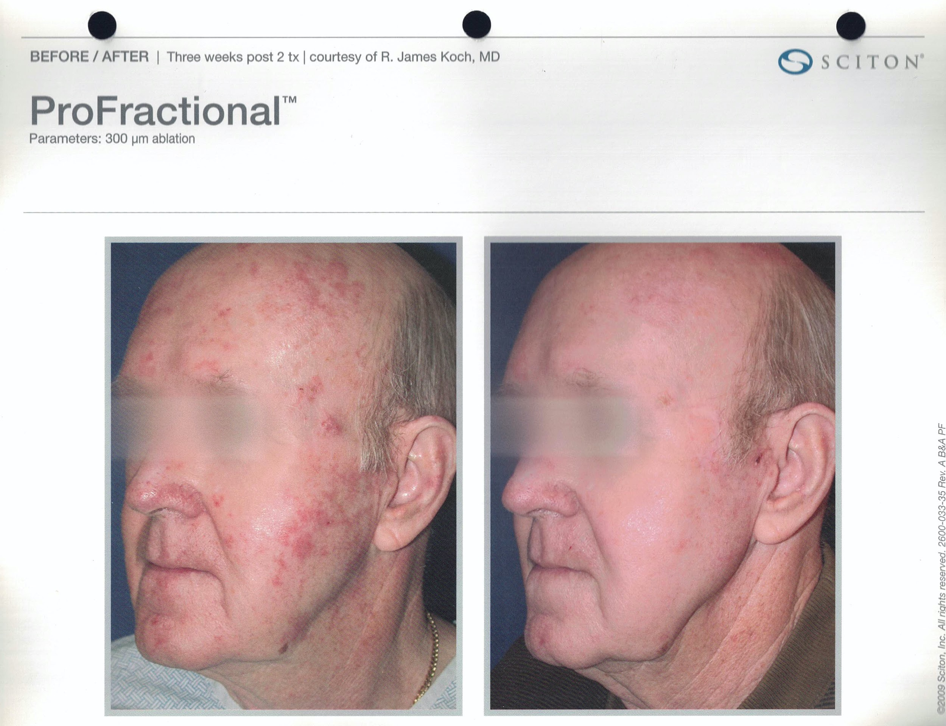
ACTINIC KERATOSIS
Dry
Rough
Pink
White
Red
Macules
Papules
Patches
Keratotic

Slide 19
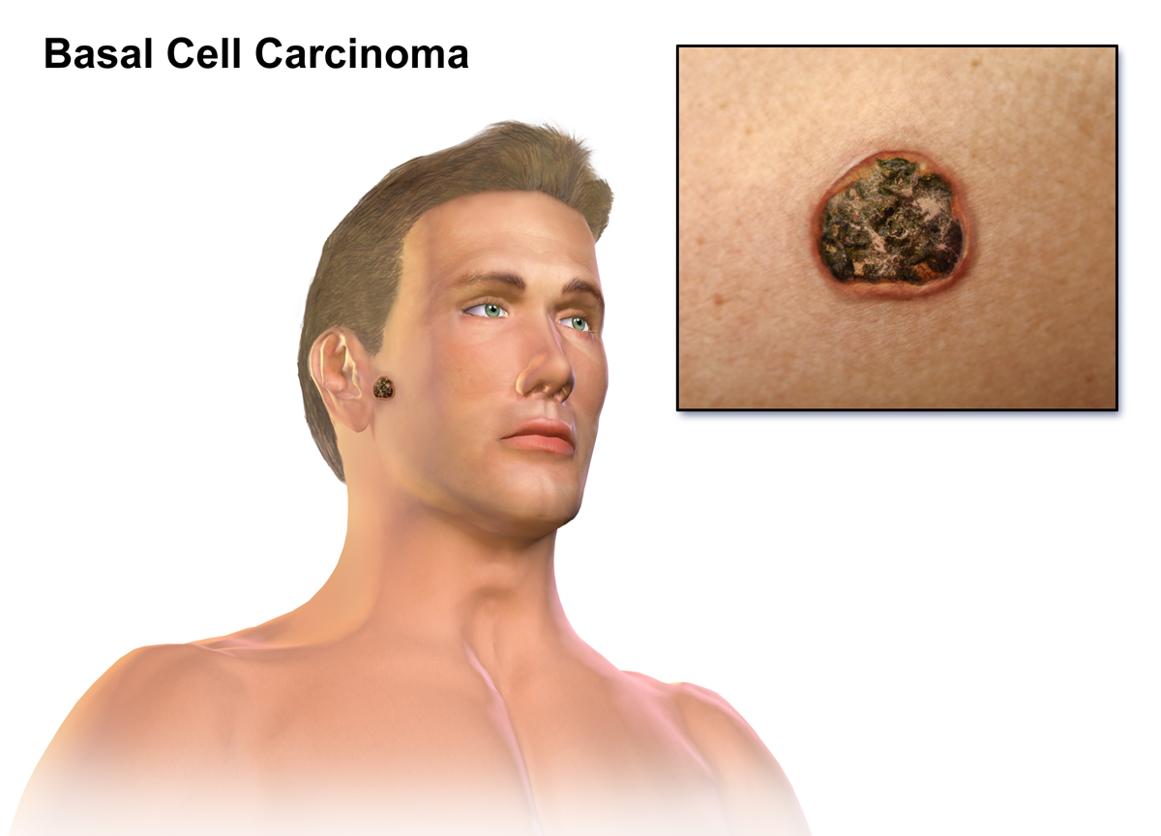
Basal Cell Carcinoma

Slide 20
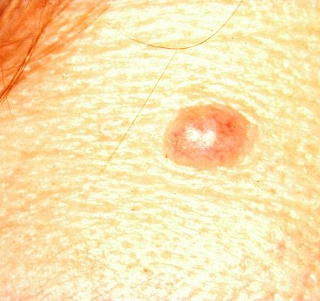
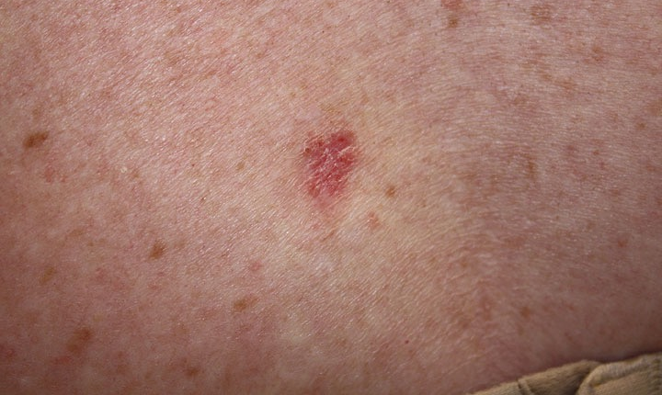
BASAL CELL CARCINOMA
SUPERFICIAL BASAL CELL CARCINOMA

Slide 21
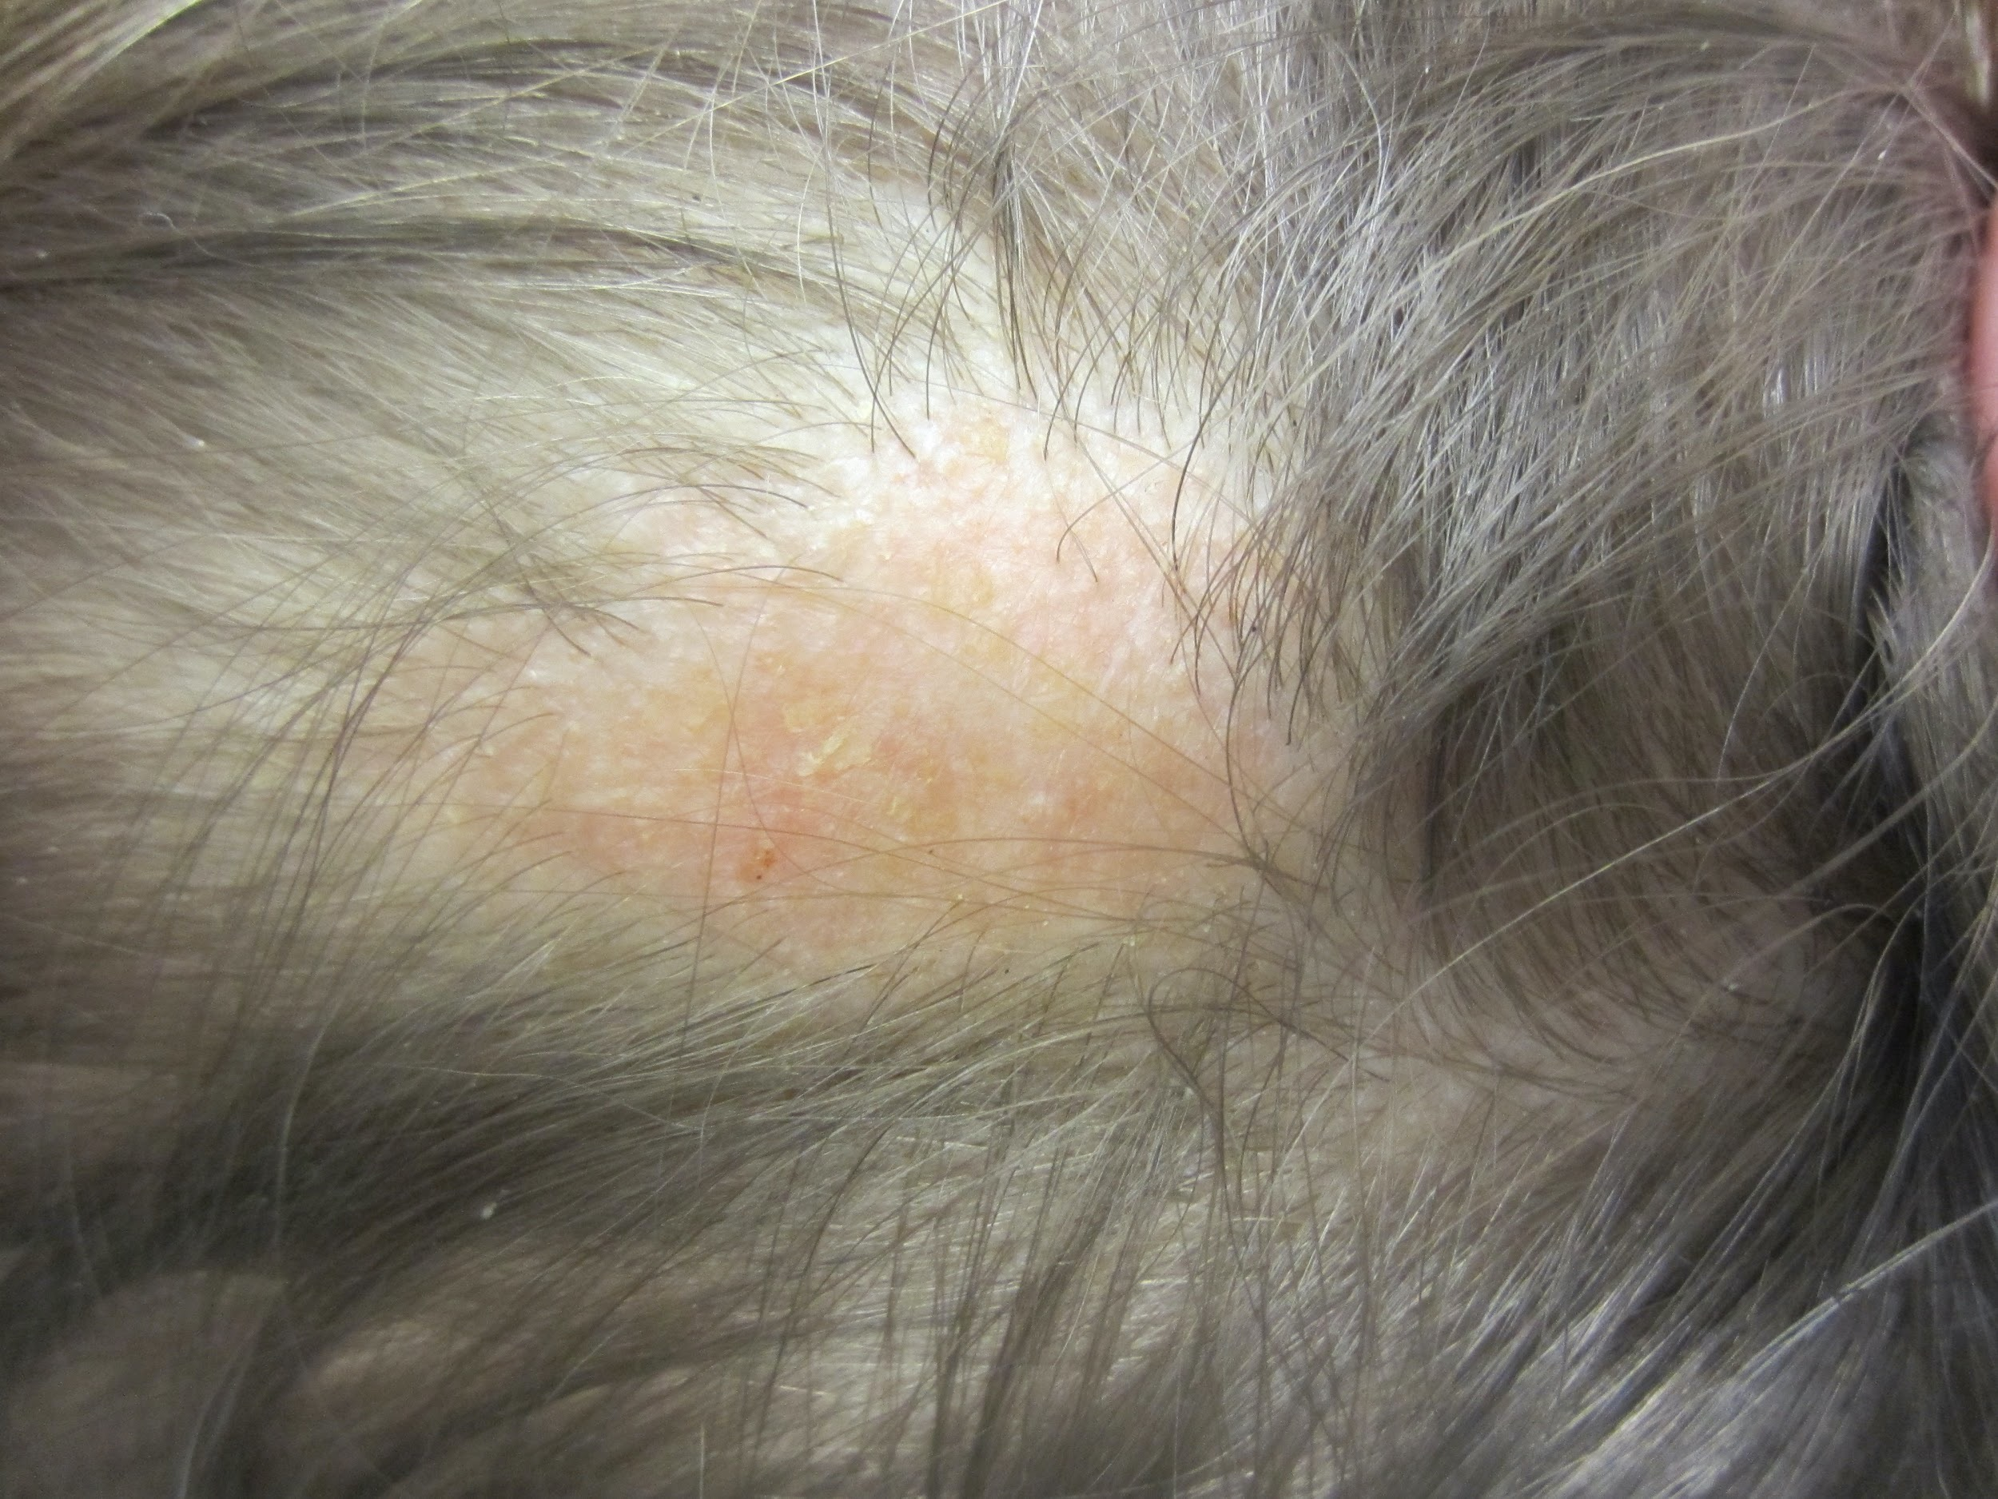
NEVUS SEBACEOUS OF JADASSOHN

Slide 22
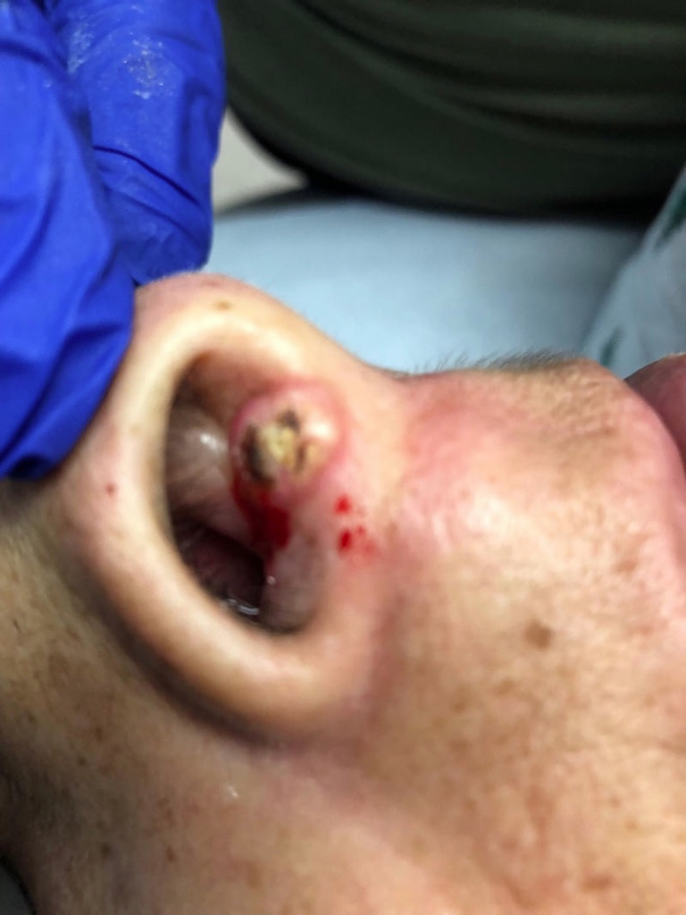

SQUAMOUS CELL
CARCINOMA

Slide 23
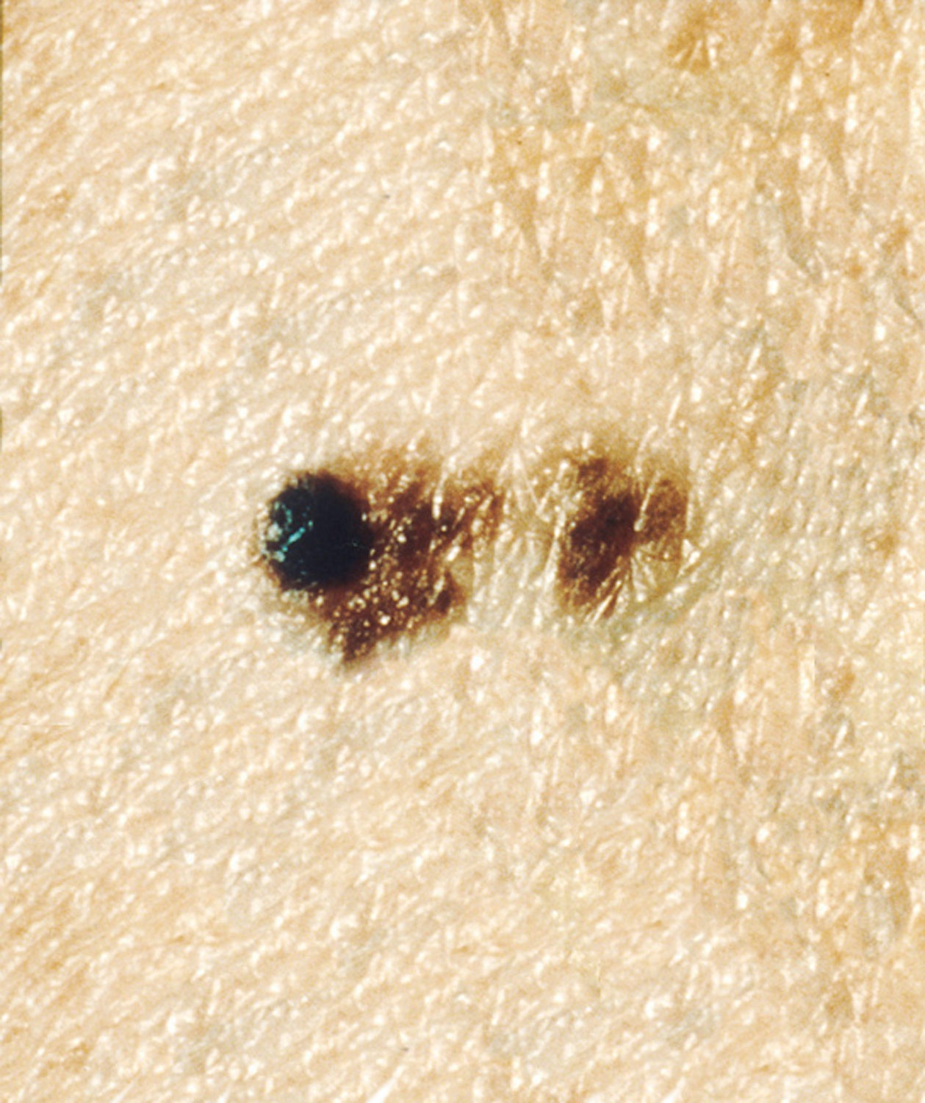
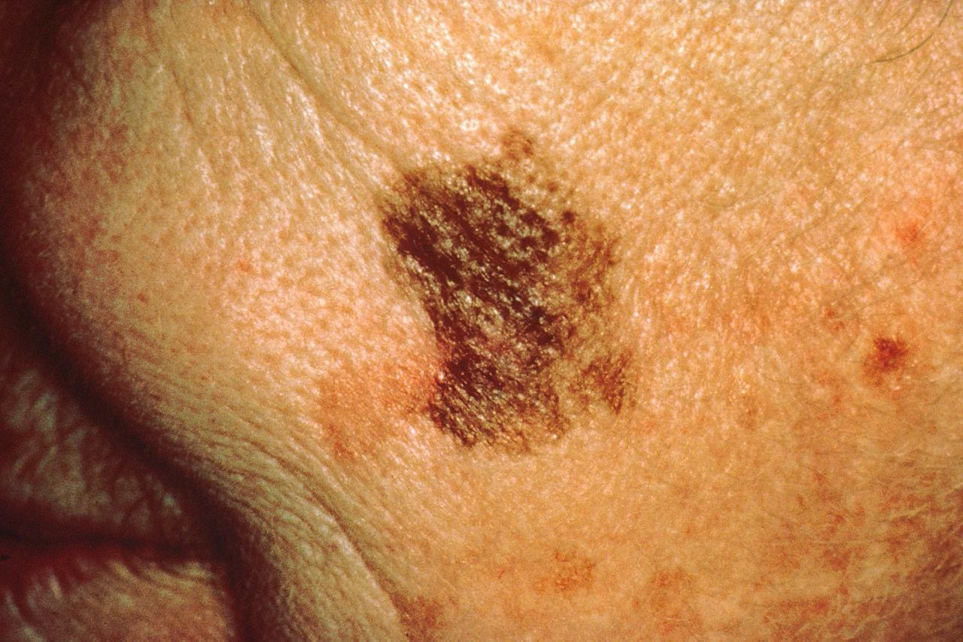
Abcde’S OF mELANOMA – Resources & Tools
What to look for:

Slide 24

MELANOMA
OUCH!

Slide 25

Say YES to Sun protection!
Since exposure to the sun’s harmful UV rays is the most preventable risk factor for skin cancer, protect your skin by:
--Seeking shade
--Wearing sun-protective clothing
--Applying sunscreen to all skin not covered by clothing
Skin cancer is the most common cancer in the world, and melanoma is the most serious form of skin cancer and sometimes, the deadliest. One in five will develop skin cancer in their lifetime. The best way to find skin cancer in its earliest and most treatable stage is by checking your skin regularly and having a dermatologist perform a focused skin cancer screening.

Slide 26
How to select a sunscreen for your skin
Physical Sunscreen
This sunscreen works like a shield, it sits on the surface of your skin, deflecting the sun’s rays.
Look for the active ingredients of zinc-oxide and/or titanium dioxide.
Opt for this sunscreen if you have sensitive skin.
Chemical Sunscreen
This sunscreen works as a sponge, absorbing the sun’s rays.
Look for one or more of the following active ingredients; oxybenzone, avobenzone, octisalate, octocrylene, homosalate and octinoxate.
This formulation tends to be easier to rub into the skin without leaving a white residue.
As long as your sunscreen is a broad-spectrum, water-resistant with an SPR 30 or higher, it can effectively protect you from the sun. Make sure you re-apply every two hours, or after swimming or sweating.

Slide 27
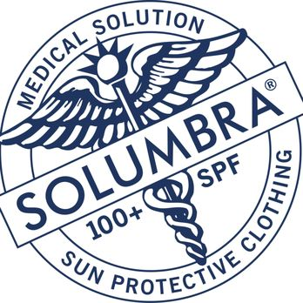

Slide 28
Detect skin cancer: Performing a skin self-exam
You don’t need x-rays or blood tests to find skin cancer early – just your eyes and a mirror. If you have skin cancer, finding it early is the best way to make sure it can be treated successfully.
Although the American Cancer Society does not have guidelines for the early detection of skin cancer, many doctors recommend checking your own skin regularly, typically once a month.
Regular skin self-exams are especially important for people who are at higher risk of skin cancer, such as people with reduced immunity, people who have had skin cancer before, and people with a strong family history of skin cancer.
A skin self-exam is best done in a well-lit room in front of a full-length mirror. You can use a hand-held mirror to look at areas that are hard to see, such as the backs of your thighs. A spouse, partner, or close friend or family member may be able to help you with these exams, especially for those hard-to-see areas like your back or scalp.
The first time you examine your skin, spend time carefully going over the entire surface. Learn the pattern of moles, blemishes, freckles, and other marks on your skin so that you’ll notice any changes next time. Be sure to show your doctor any areas that concern you.

Slide 29
MELANOMA

Slide 30
SEBACEOUS HYPERPLASIA
SYRINGOMAS
XANTHELASMAS
ACHROCORDONS
MILAL CYSTS
VERRUCA PLANA/VULGARIS
BIRTHMARKS-PIGMENTED AND VASCULAR
BENIGN LESIONS
Notes:
You might ask, “Dr Lori, Why do I have to know how to DIAGNOSE these skin lesions?” I’ll tell you why. You are TREATING skin conditions. You want to know what you’re recommending and why...you better know, so you know if you caused this condition!
You might ask, “Dr Lori, Why do I have to know about these skin lesions?” I’ll tell you why. You better not be missing CA!
Lucky for you...you have been in Derm Boot Camp 101 to learn how to educate pts on lesions and make pts happy!
Lucky for you...you have a captive audience for whatever the #1 chief complaint was to get them in your hot seat.
Lucky for you...you can educate your patient to make educated choices! If you can’t help...don’t and refer out!
Learn. Educate.Network. Be the mentor!

Slide 31
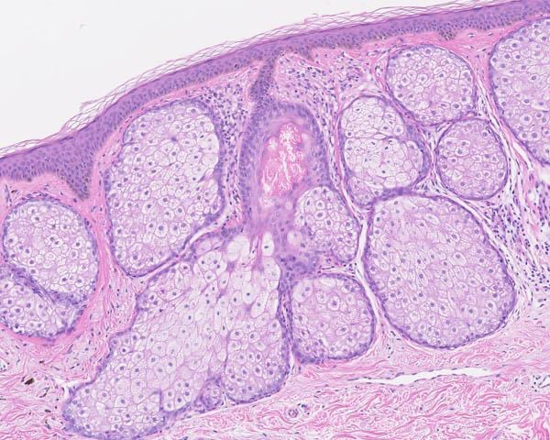
SEBACEOUS HYPERPLASIA

Slide 32
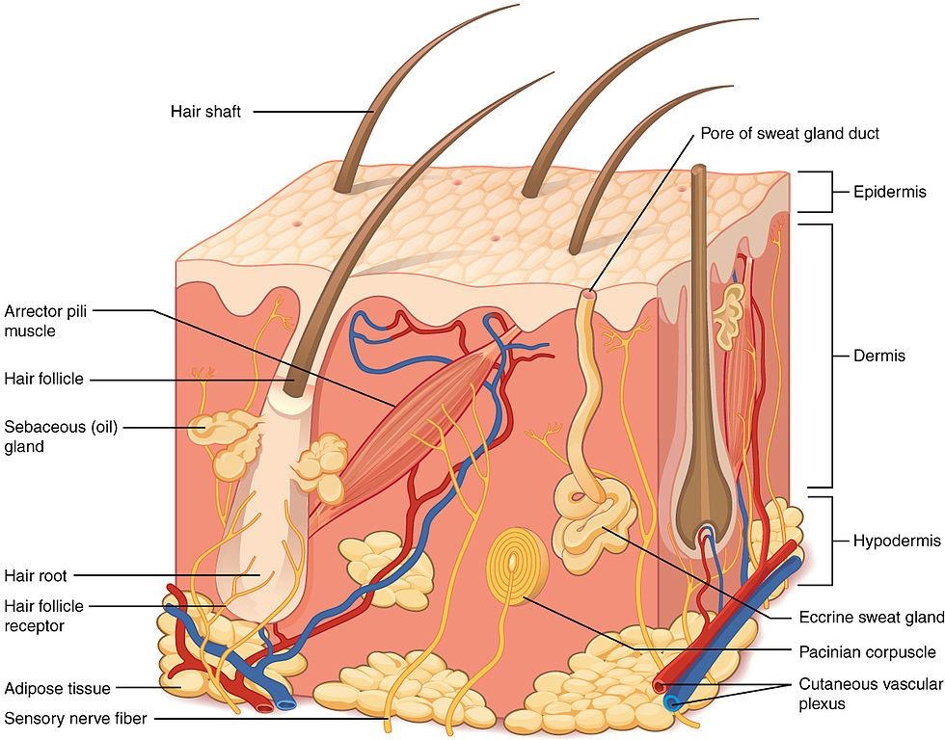
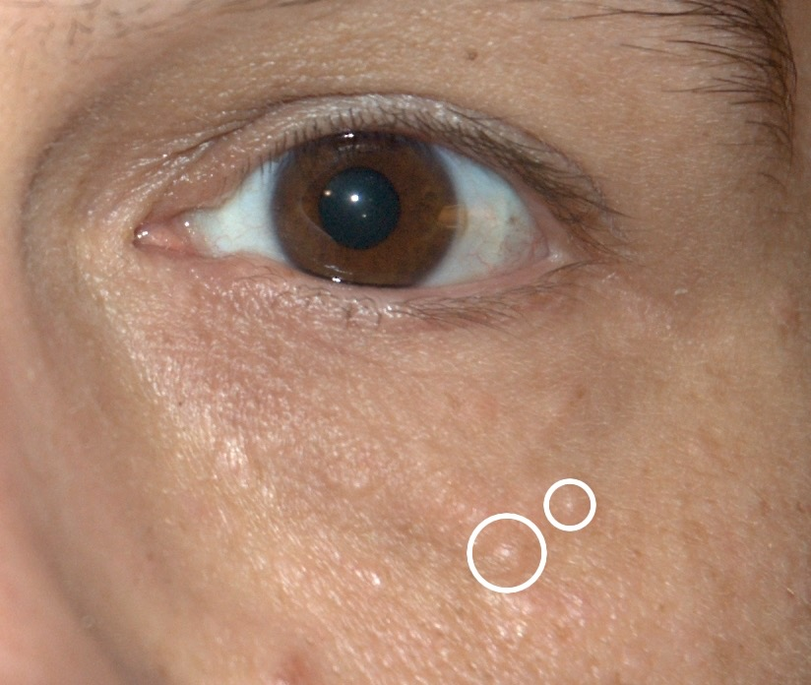
SYRINGOM INTRA-EPIDERMAL ECCRINE SWEAT GLAND TUMORSYROn
SYRINGOMA: Intra-epidermal eccrine sweat gland tumor

Slide 33
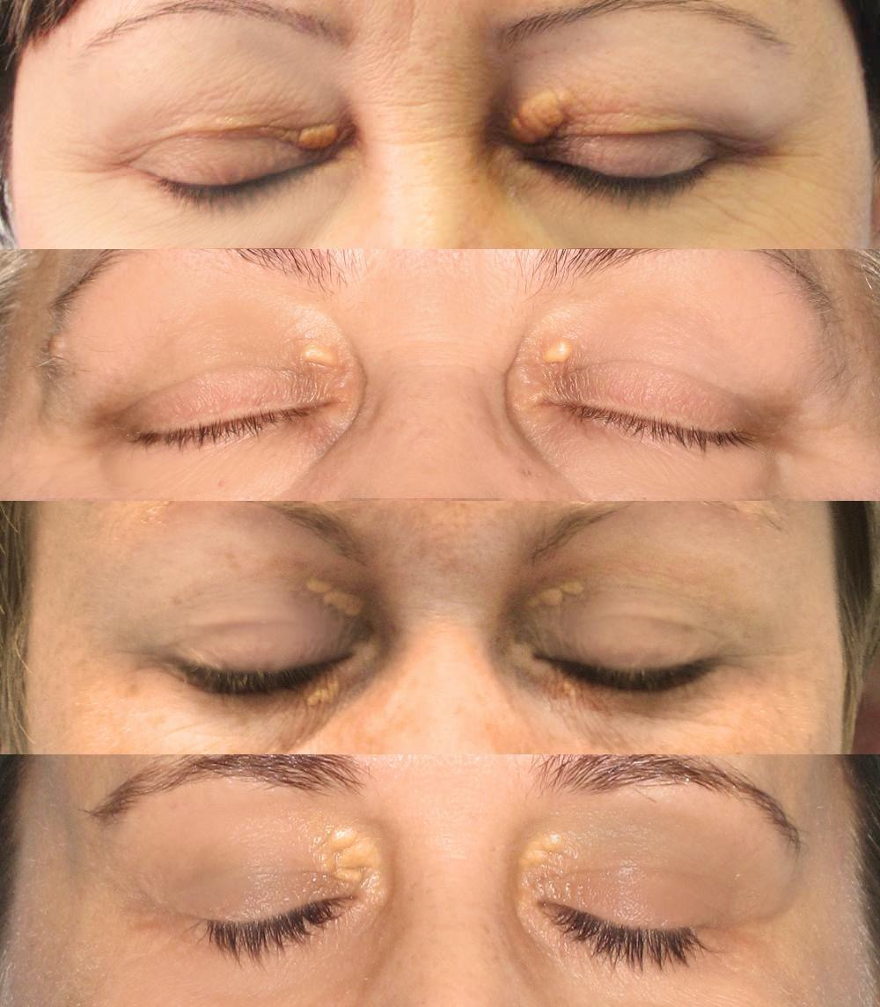
XANTHELASMAS

Slide 34
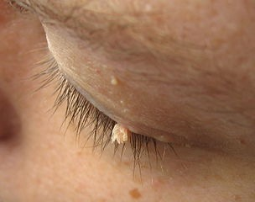
ACHROCHORDON OR FILIFORM VERRUCA

Slide 35
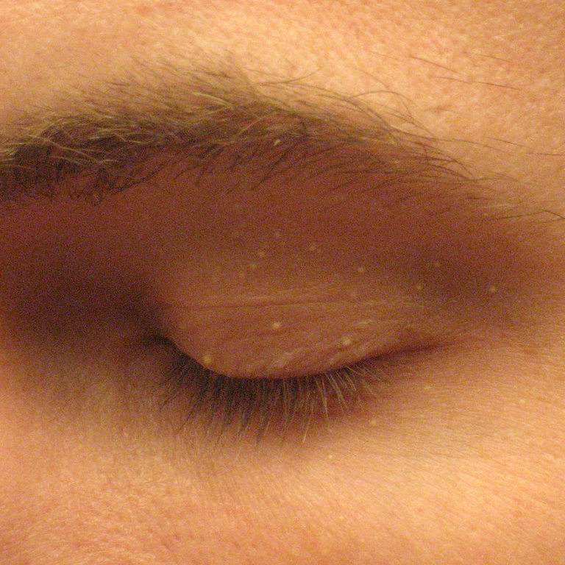
MILIAL CYSTS

Slide 36
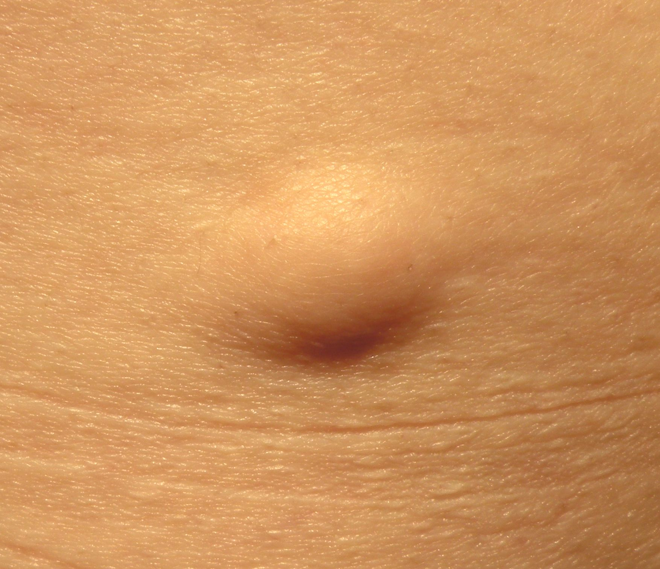
EPIDERMAL CYST a.k.a.SEBACEOUS CYST

Slide 37
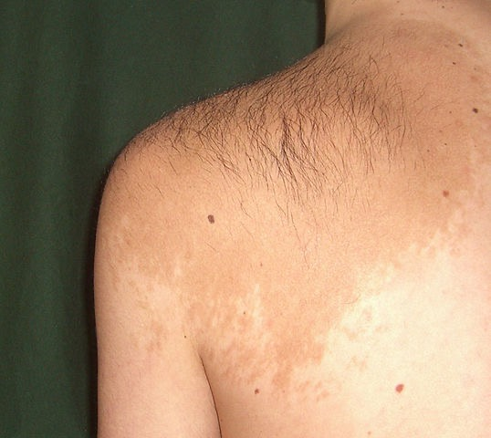
PIGMENTED BIRTHMARK: BECKER’S HAIRY NEVUS

Slide 38
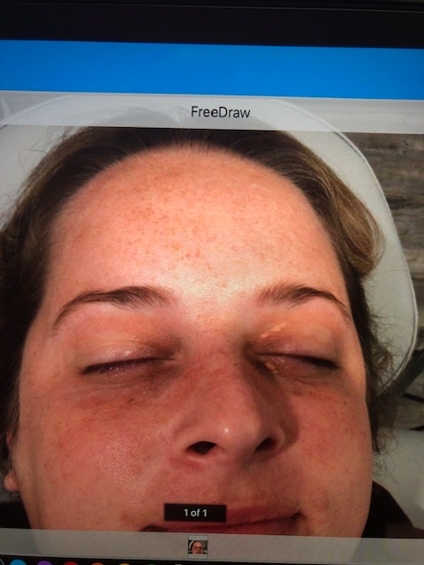
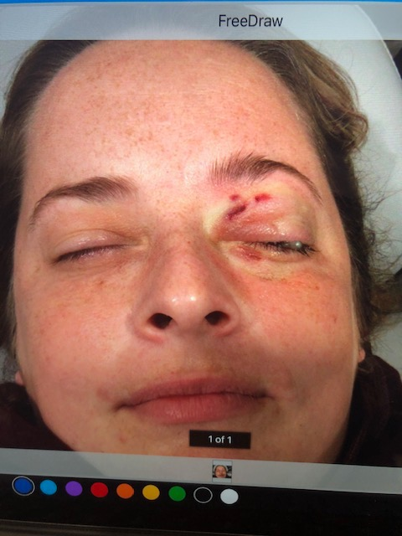
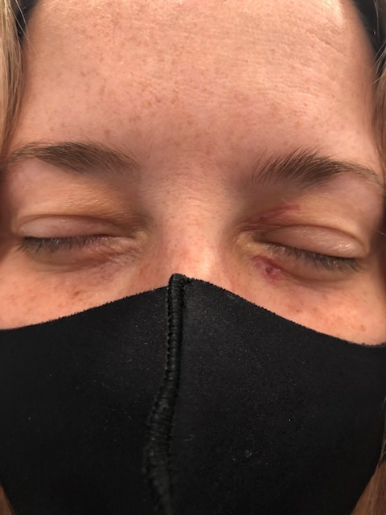

Slide 39
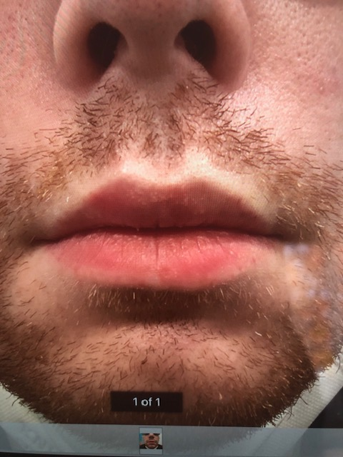
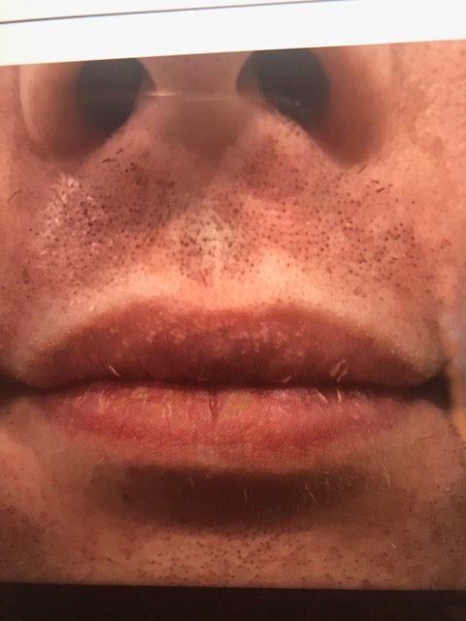
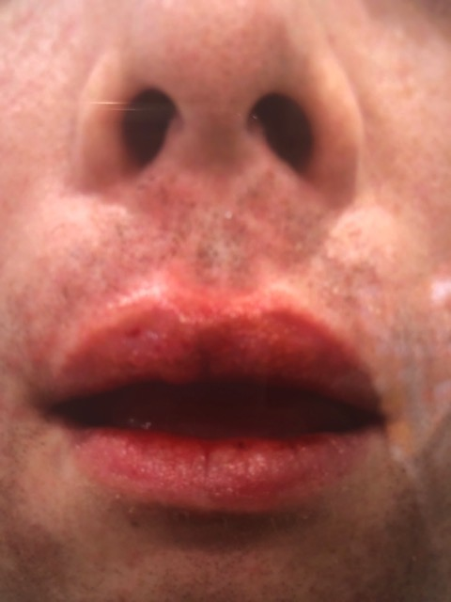

Slide 40

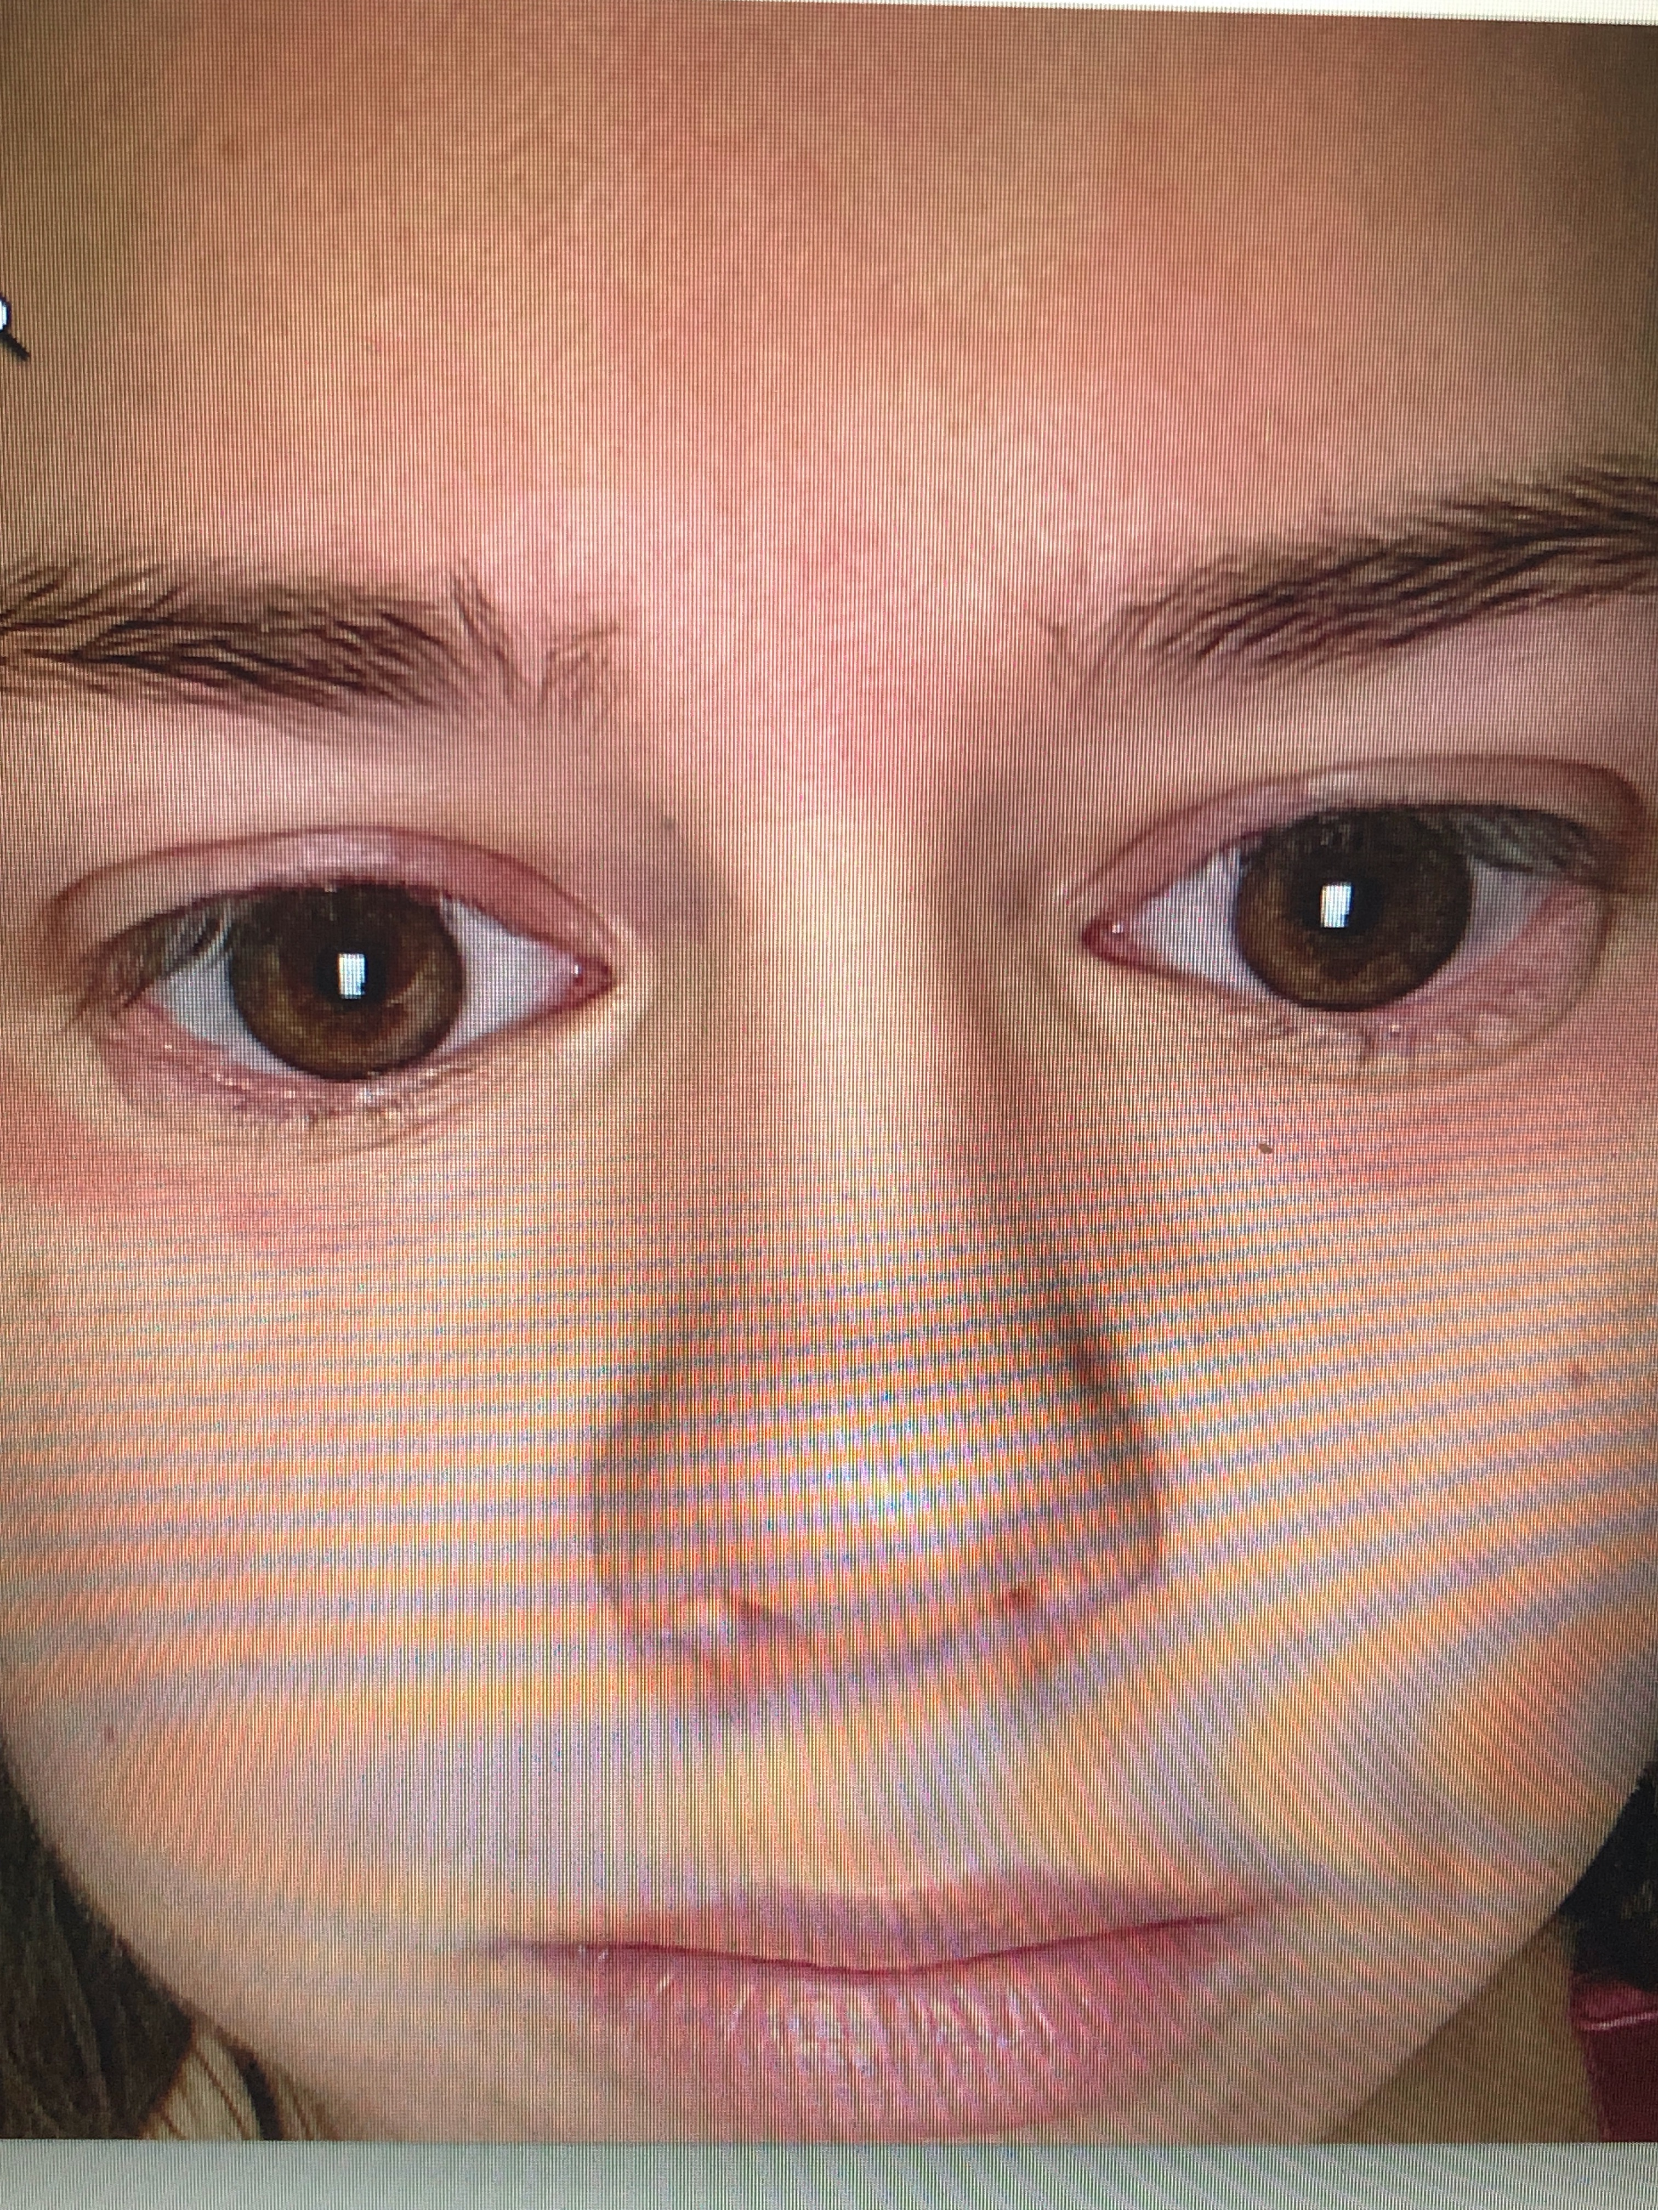

Slide 41
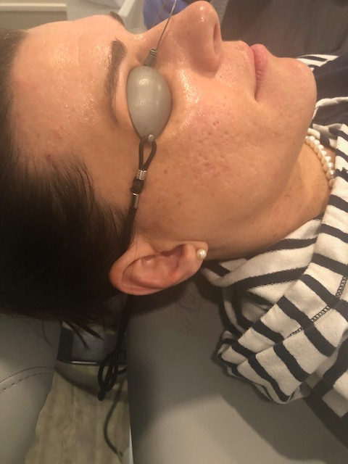
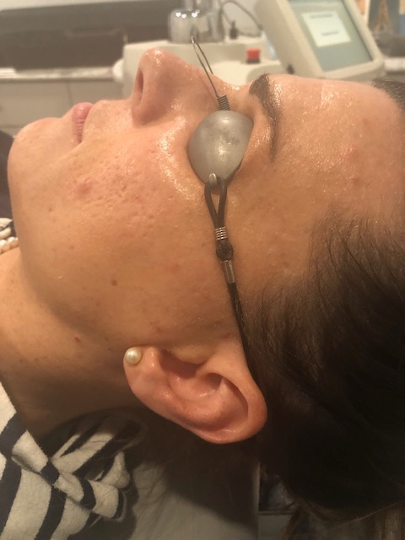
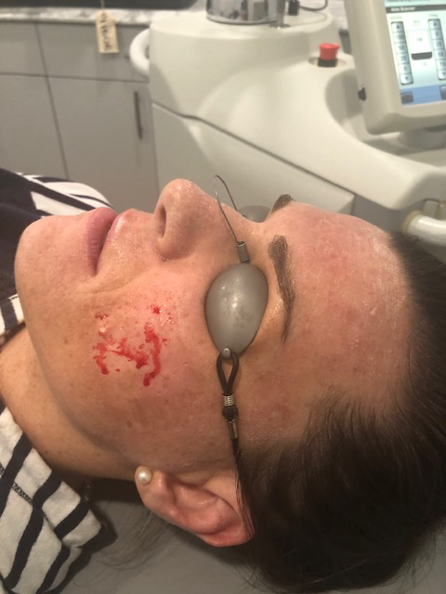
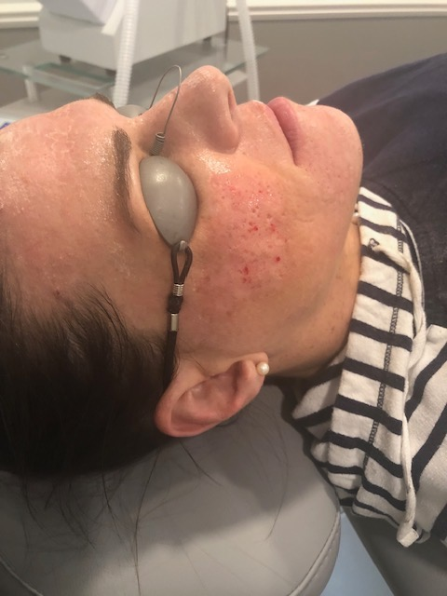

Slide 42
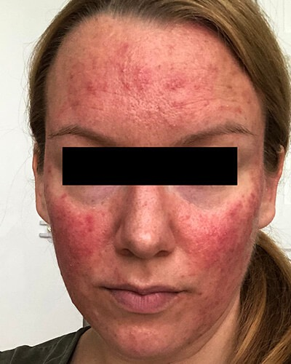
rosacea
Rosacea can vary substantially from one patient to another but commonly result in flushing and persistent facial redness. Small blood vessels may also become visible in some patients.
The disorder is more frequently diagnosed in women but tends to be more sever in men.
Tailored individual treatment through a range of oral and topical treatment is available through a dermatologist.

Slide 43
See a Dermatologist regularly
Prevention is always important.
Annual Dermatology appointments can help you check for skin cancers early.
To make an appointment:
Lori A. Haddad, DO
Beacon Skin & Surgeries
110 W. South Blvd. 37595 W. Seven Mile Rd.
Suite 100 Suite 240
Rochester Hills, MI 48307 Livonia, MI 48152
Office: (248) 852-1900 Office: (248) 852-1900
Coming soon in August, new location off Rochester Rd. in Troy

